Slide 1
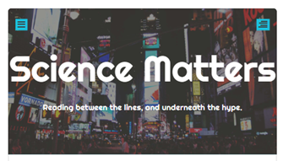

Being Reasonable About Climate Change
Notes from a Curious Generalist
Introducing highlights from an accidental blog with 3400 posts since 2015 on science-related issues. Ron Clutz
rclutz.com

Slide 2
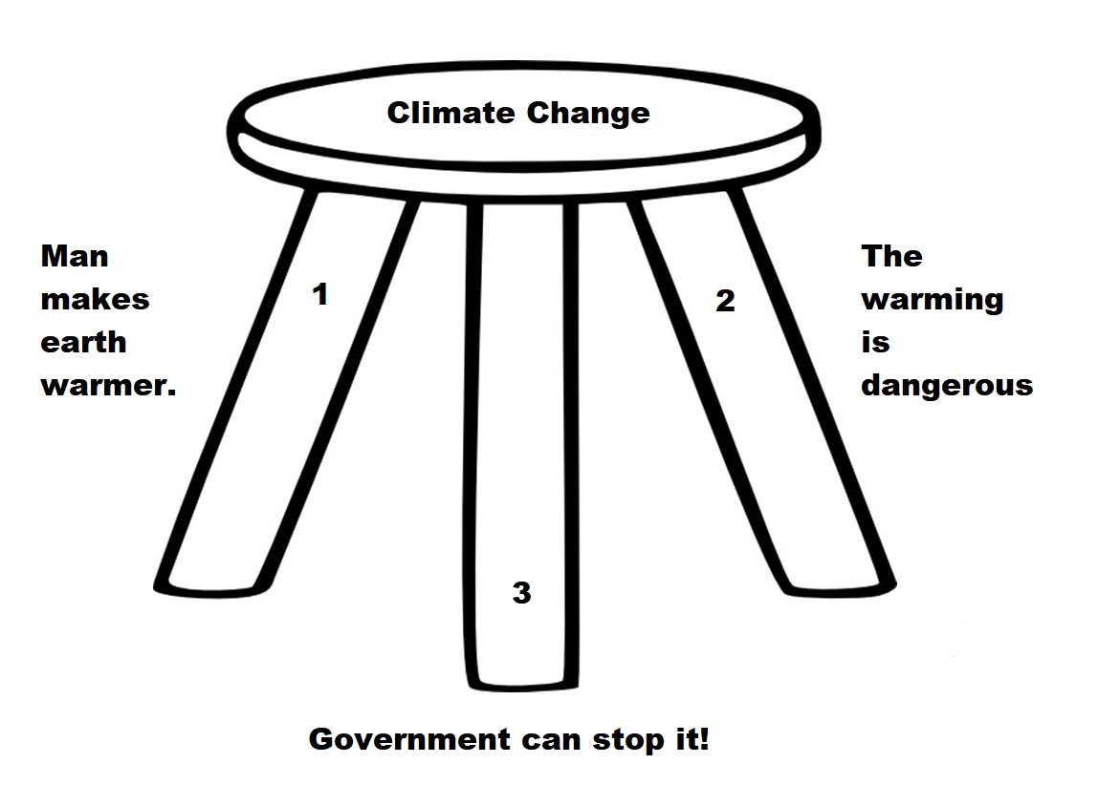
Climate Change is a three-legged stool.
The claim falls when any premise fails.

Slide 3
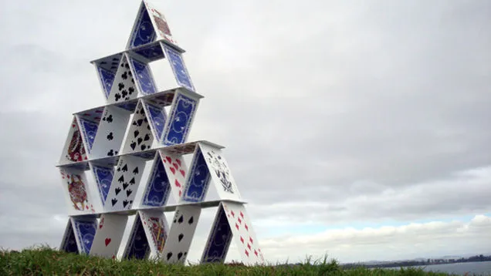
Climate science, impacts and policies also appear as a house of cards.

Slide 4
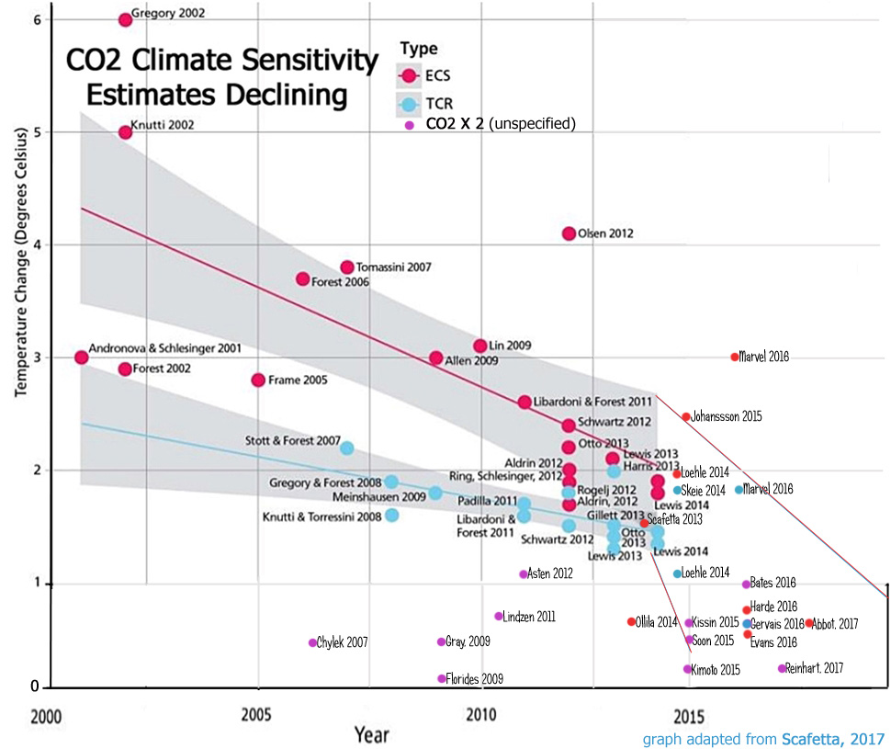
Supposition 1: Humans make the climate warmer.
But estimates vary widely and are declining.

Slide 5
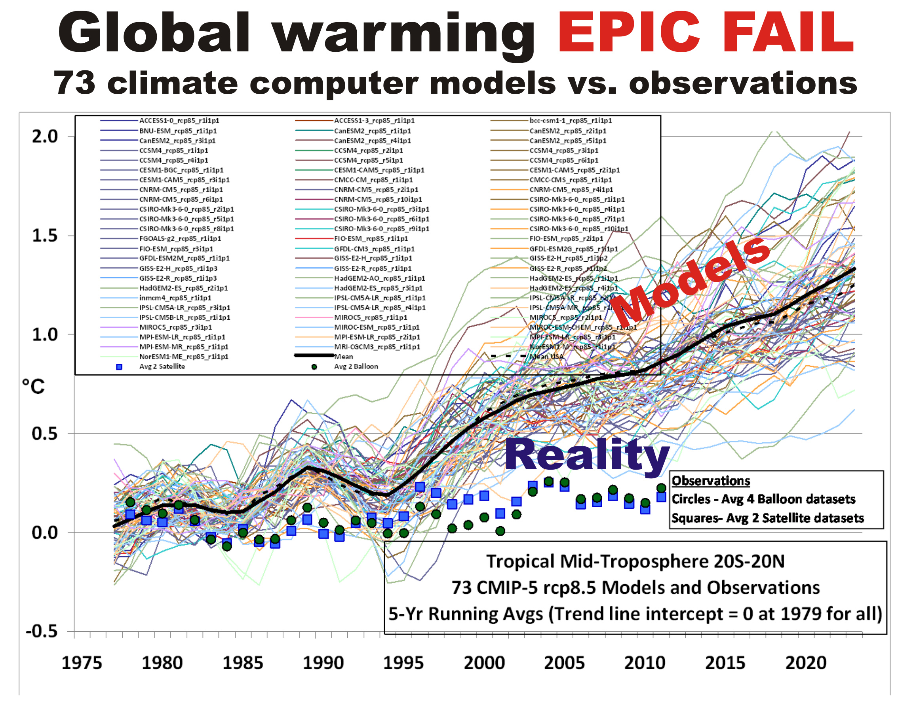
Supposition 1: Humans make the climate warmer.
But observed warming is much lower than Climate Models show.

Slide 6
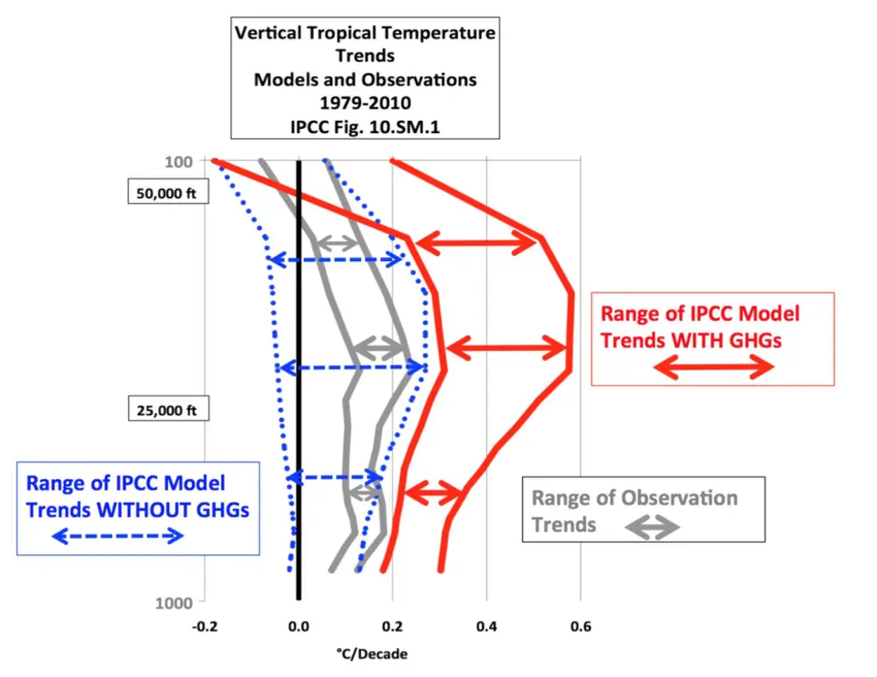
Supposition 1: Humans make the climate warmer.
But Climate Models improve when GHG sensitivity is removed.

Slide 7
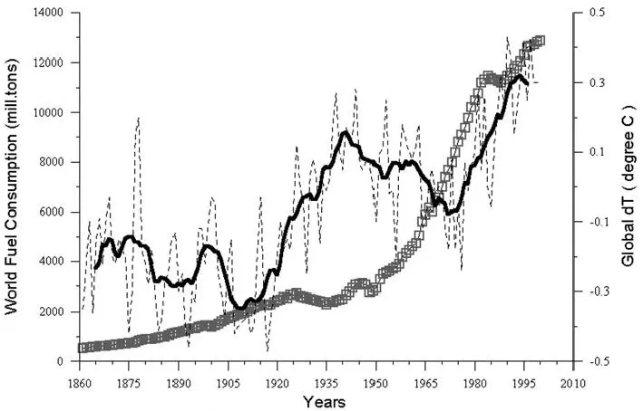
Supposition 1: Humans make the climate warmer.
But Temperature correlates poorly with FF consumption.

Slide 8
Supposition 2: The Warming is Dangerous
The media has increasingly filled its time and pages with reports of “multiple lines of evidence” proving CAGW. Typically these consisted of :
Global temperature rise
Warming oceans
Shrinking ice sheets
Glacial retreat
Decreased snow cover
Sea level rise
Declining Arctic sea ice
Extreme events
Ocean acidification
However, all of these are equivocal, involving signal and noise issues. Note that Global warming is the basis for all the other claimed extremes. And in any case, the fact of any changes does not in itself prove human causation.

Slide 9
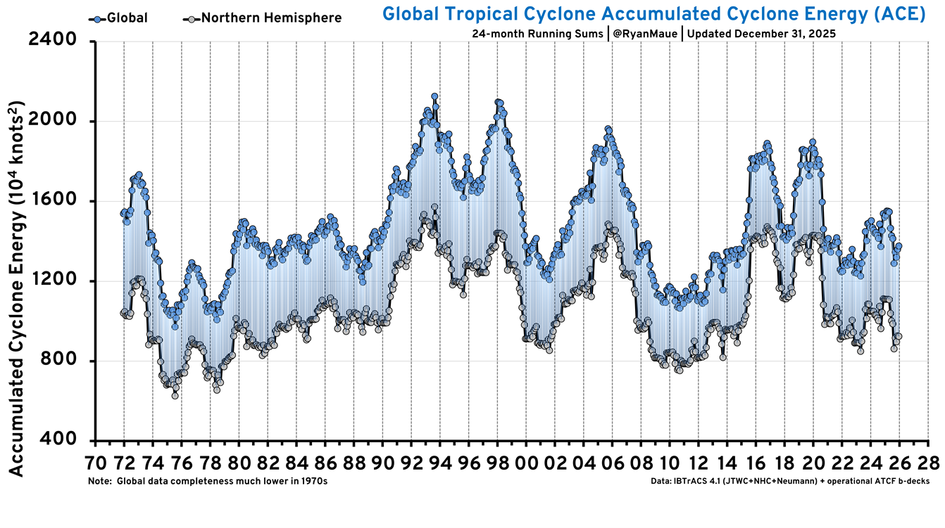
Supposition 2: The Warming is Dangerous
But Storms are not more extreme today.

Slide 10
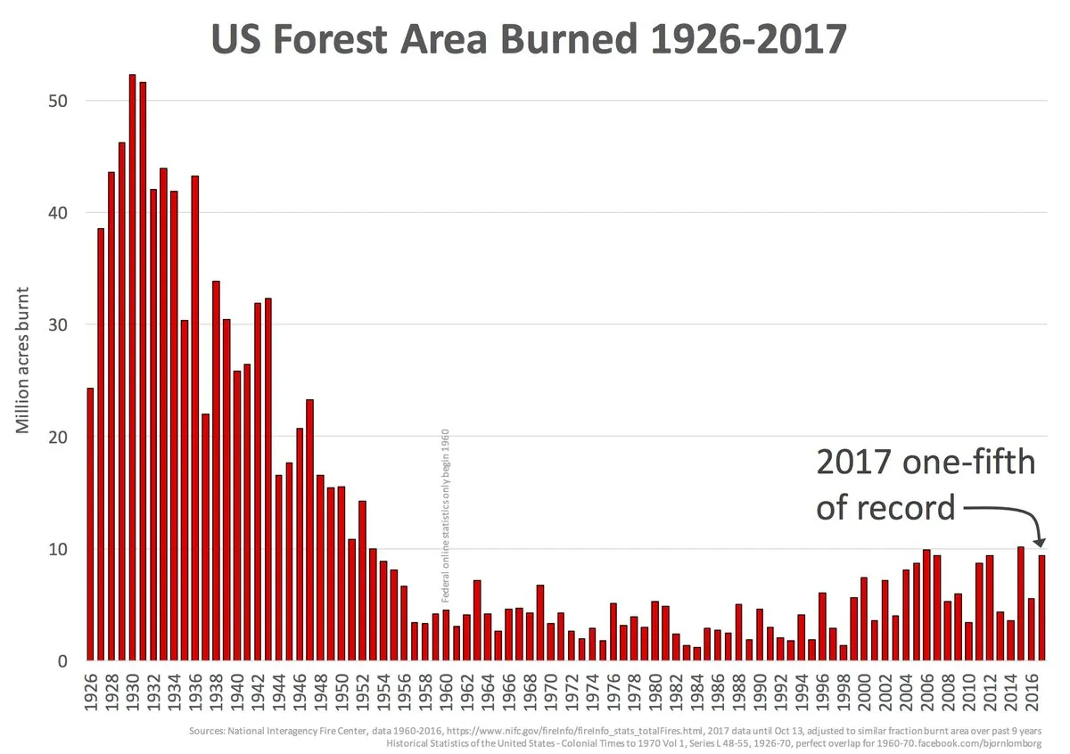
Supposition 2: The Warming is Dangerous
And Wildfires were worse in the past.

Slide 11
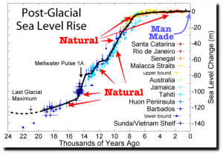
Supposition 2: The Warming is Dangerous
But: Sea Level Rise is not accelerating.

Slide 12
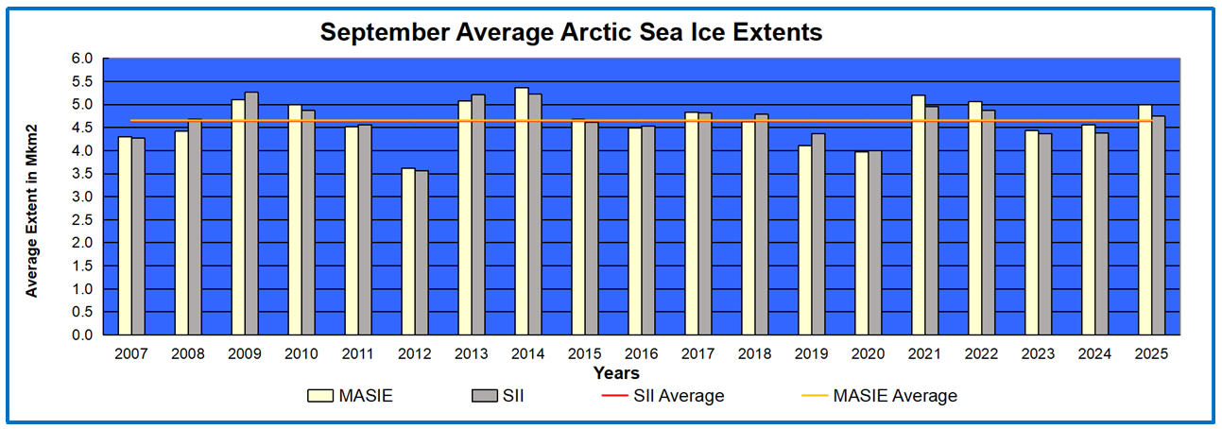
Supposition 2: The Warming is Dangerous
But: Arctic Ice has not declined since 2007.

Slide 13
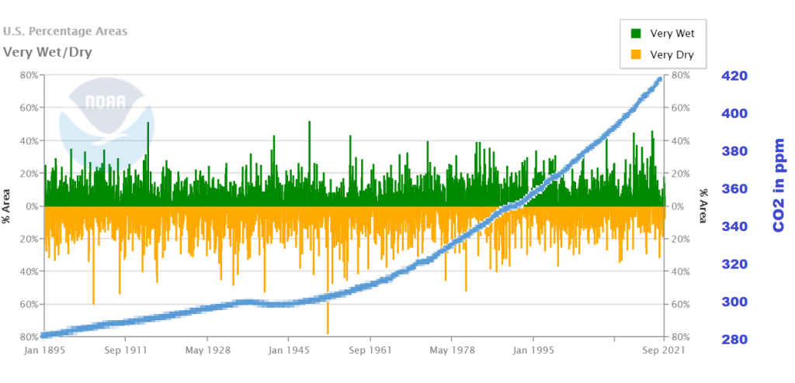
Supposition 2: The Warming is Dangerous
But all of these are within the range of past variability.

Slide 14
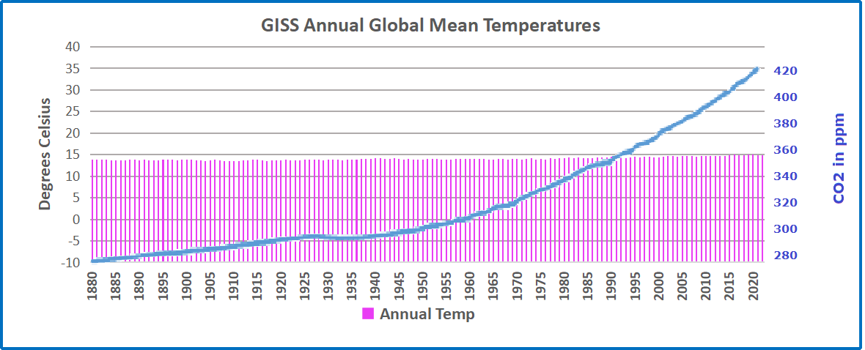
Supposition 2: The Warming is Dangerous
In fact our climate is remarkably stable,
mildly warming after the LIttle Ice Age.

Slide 15
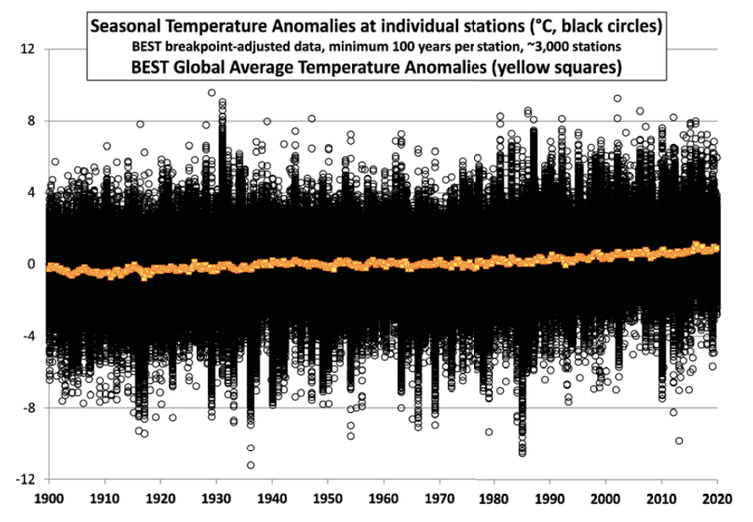
Supposition 2: The Warming is Dangerous
In fact our climate is remarkably stable,
compared to seasonal variances.

Slide 16
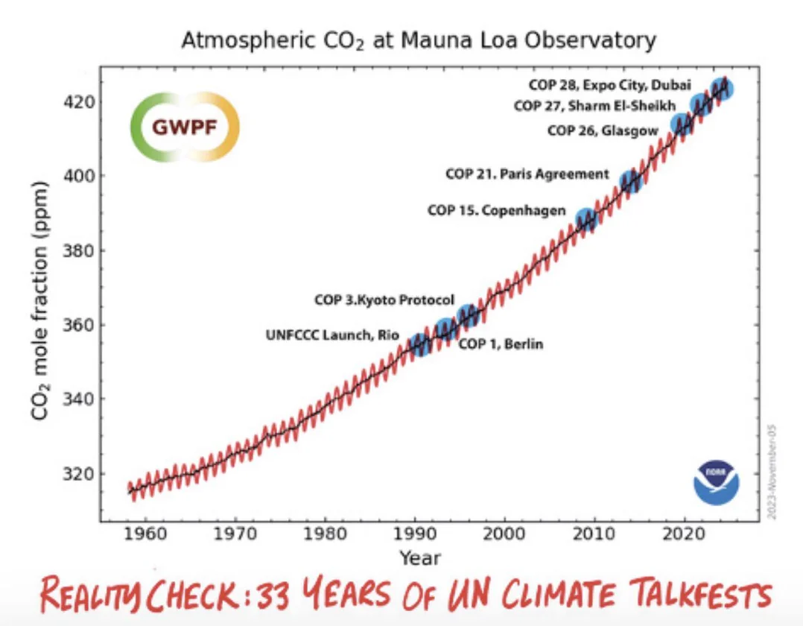
Supposition 3: Government Can Stop Climate Change.
In fact our climate is remarkably stable,

Slide 17
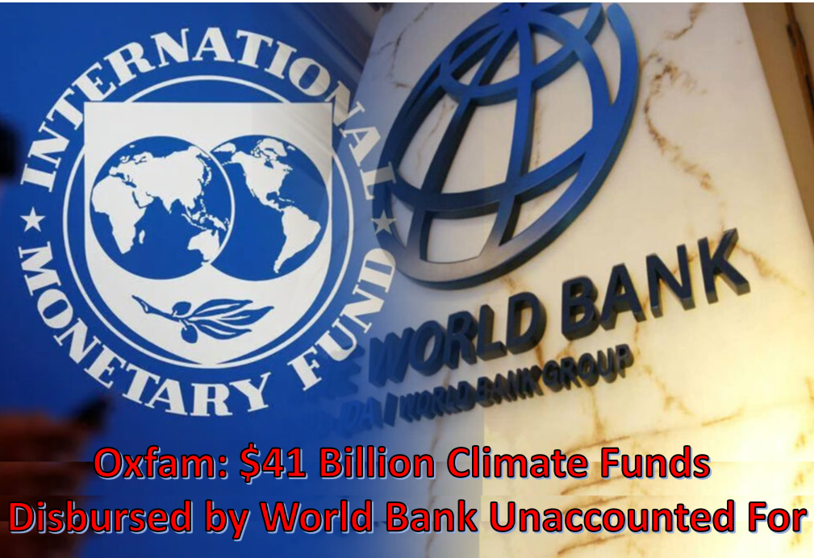
Supposition 3: Government Can Stop Climate Change.
Billions have been spent to little effect or accountability

Slide 18
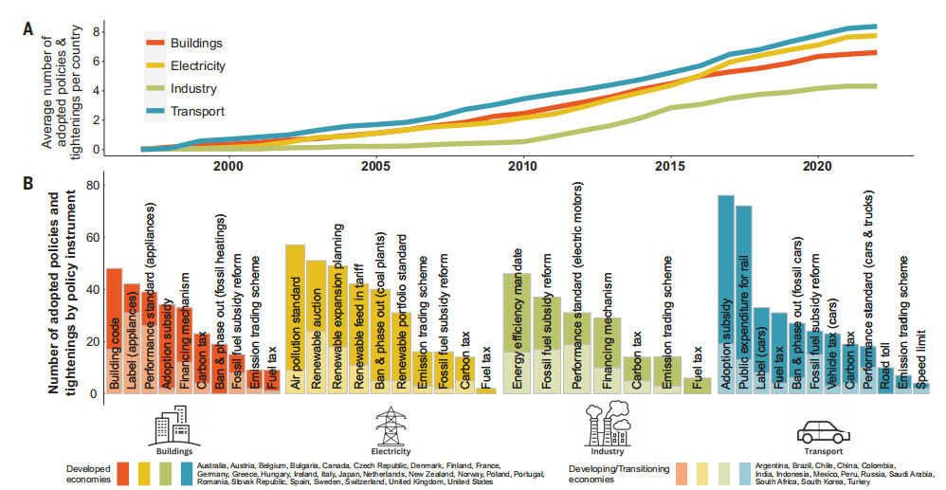
Supposition 3: Government Can Stop Climate Change.
Global Analysis of Climate Policies
96% of the effort and trillions of $$$ were spent to no avail.

Slide 19
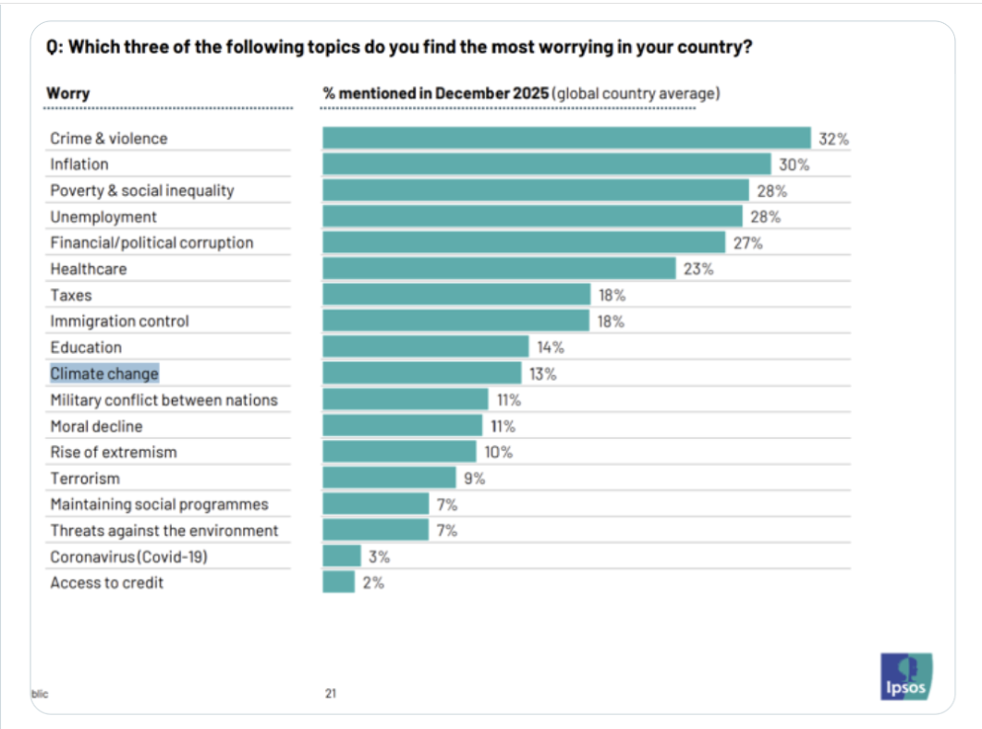
Supposition 3: Government Can Stop Climate Change.
Most of world population has other priority concerns.

Slide 20
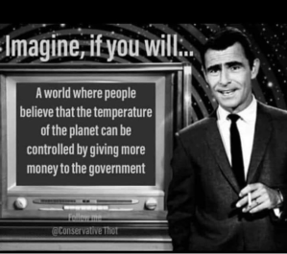
Supposition 3: Government Can Stop Climate Change.
.

