Slide 1
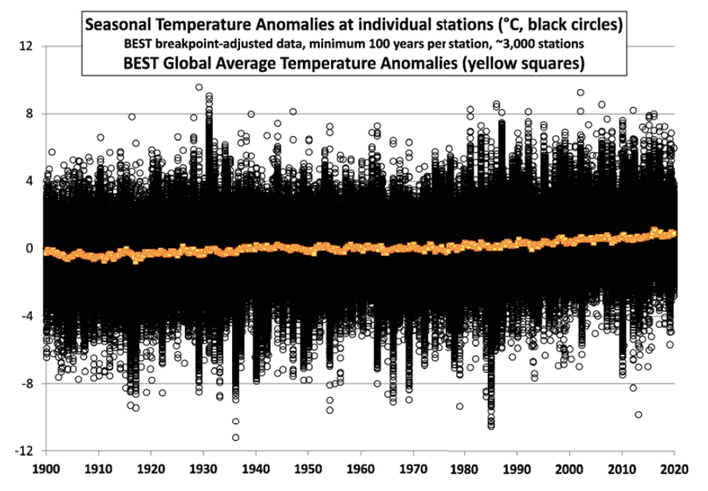
What is Global Temperature? Is it Warming?
“The warming we have had over the last 100 years is so small that if we didn’t have meteorologists and climatologists to measure it, we wouldn’t have noticed it at all.” -- Lennart Bengtsson, Climatologist

Slide 2
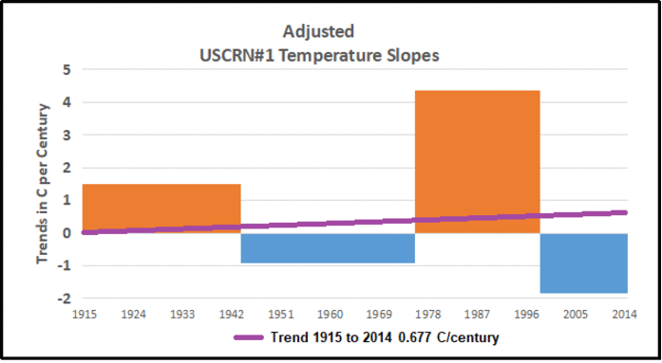
The Adjustment Problem with Temperature Records
Columns in the charts show average temperature trends for four multi-decadal periods within the century depicted. Trends were computed and compiled from absolute temperatures recorded at 23 CRN#1 stations spread around the continental US. The unadjusted records were quite mixed and collectively showed a flat century trend. However, adjusted records from the same stations showed warming of 0.68 over the century.

Slide 3
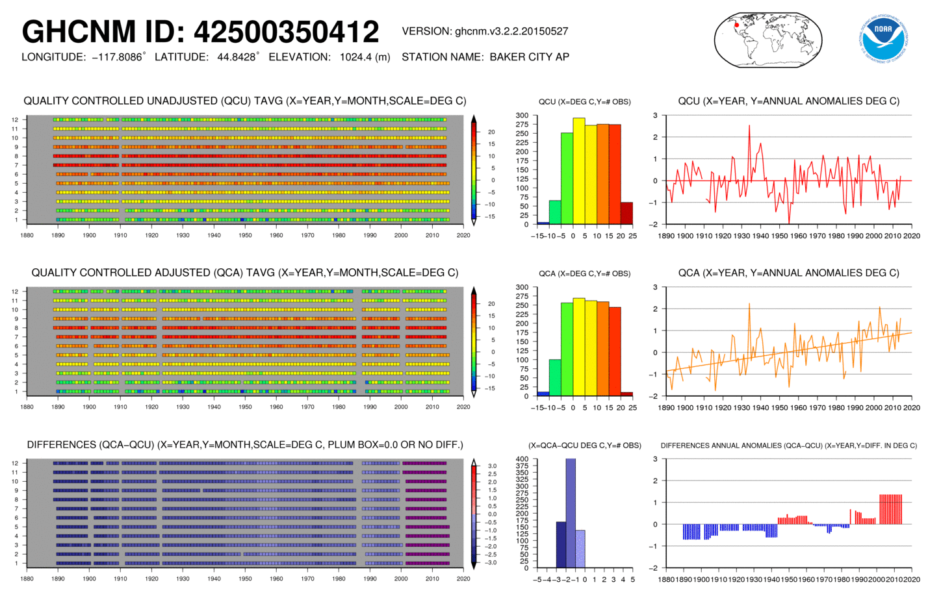
Added Warming Example 1 -- 350412 Baker City, Oregon
Over 125 years GHCN v.3 unadjusted shows a trend of -0.0051 C/century. The adjusted data shows +1.48C/century. How does the difference arise? The coverage is about the same, though 7 years of data are dropped in the adjusted file. However, older values are systematically lowered in the adjusted version: e.g prior to 1911, adjusted temperatures decade by decade are cooler by more than -2C each month.

Slide 4
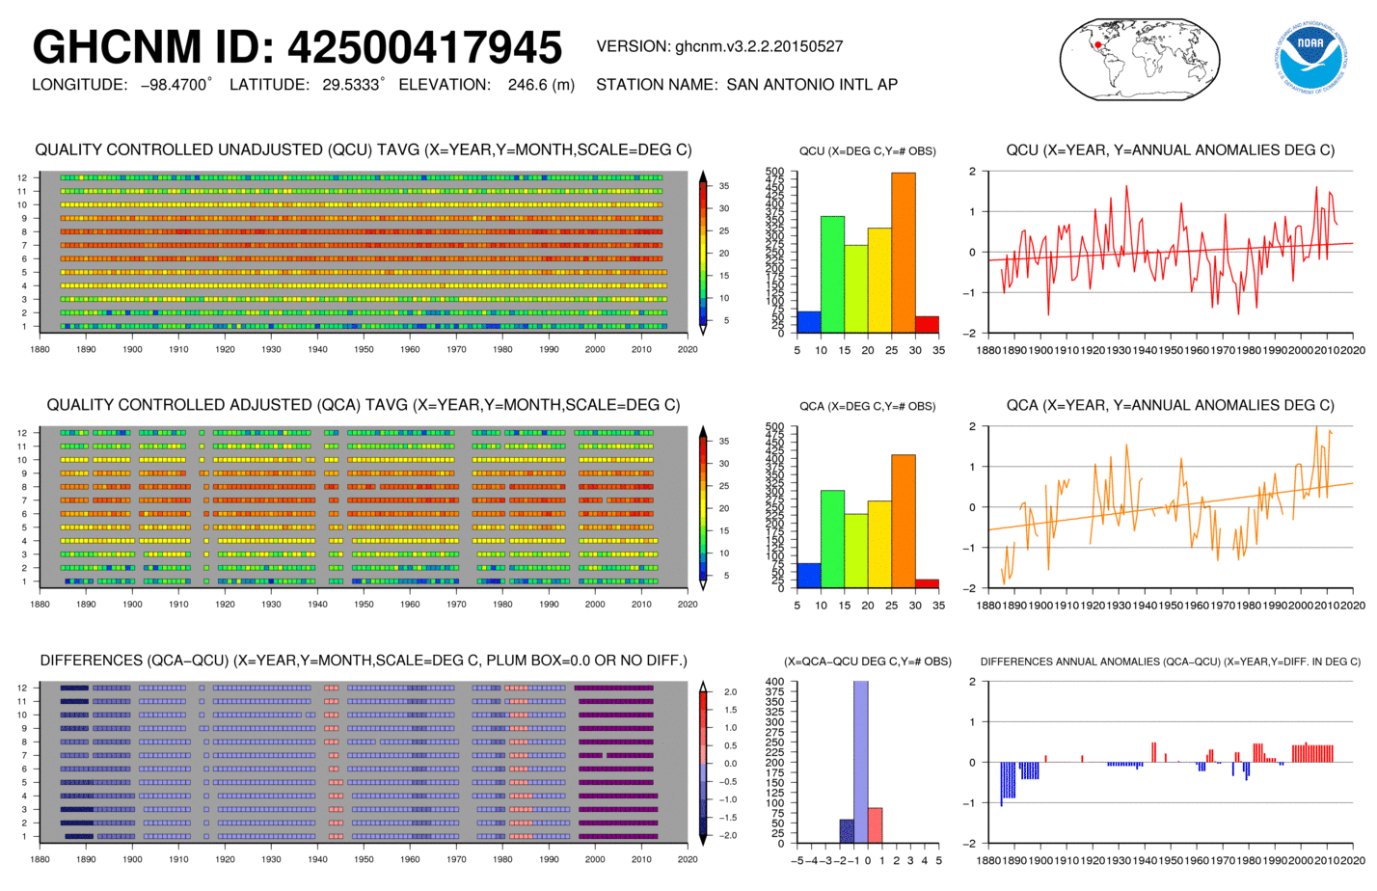
Added Warming Example 2 -- 417945 San Antonio, Texas
Here the unadjusted record had a complete 100% coverage, and the adjustments deleted 262 months of data, reducing the coverage to 83%. In addition, the past was cooled, and temperatures since 1997 were increased by about 0.5C each year. Due to deleted years of data along with recent increases, San Antonio went from an unadjusted trend of +0.30C/century to an adjusted trend of +0.92C/century, tripling the warming at that location.

Slide 5
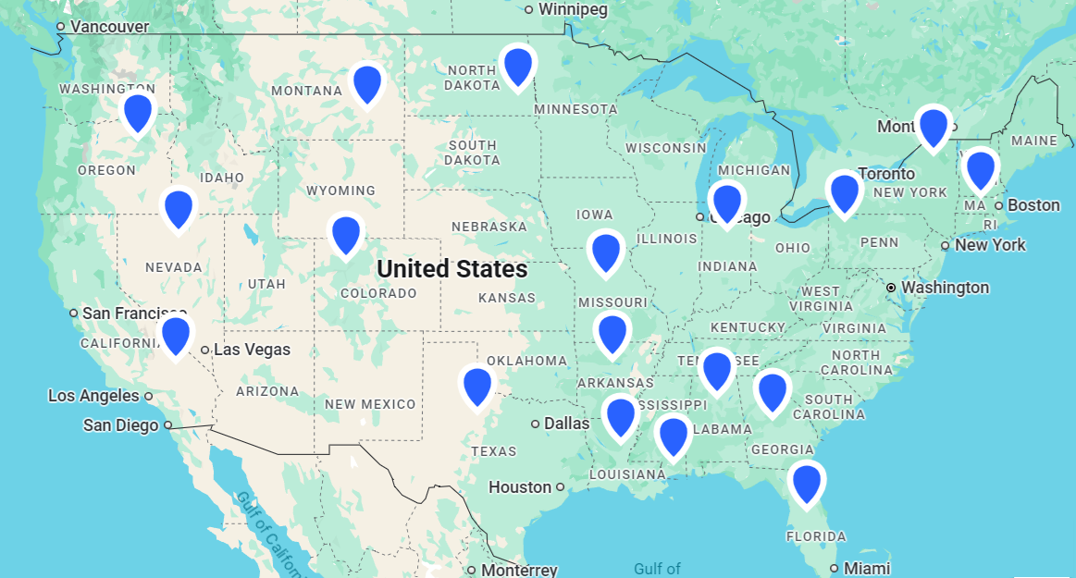
Study of Long Term US Stations Certified CRN#1
These 23 US stations comprise a random sample for studying the effects of adjustments upon historical records. All these USHCN stations inspected by surfacestations.org met the CRN standard for #1 rating. The sample was formed on a physical criterion, siting quality, independent of the content of the temperature records. It is startling to see how distorted and degraded are the adjusted records compared to the records submitted by weather authorities.

Slide 6
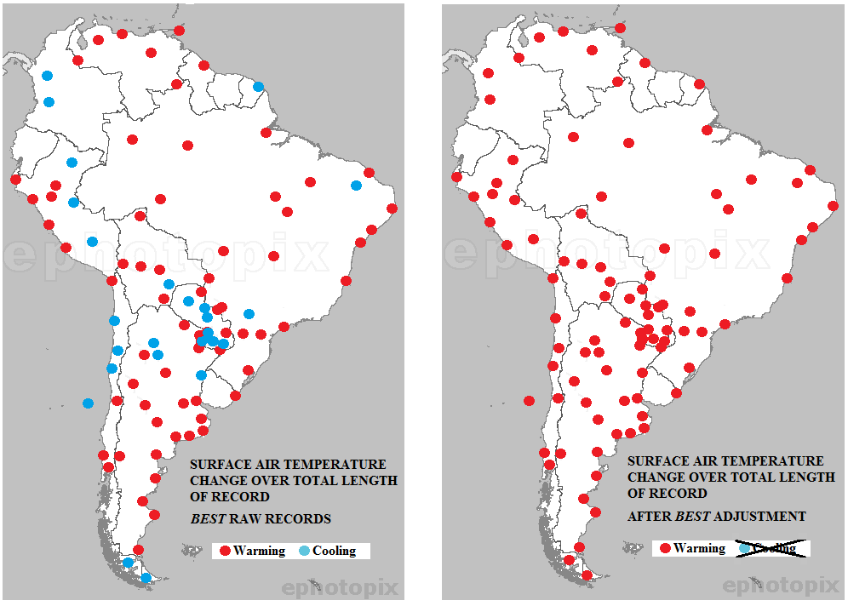
Too Many Temperature Missteps to Ignore or Dismiss

Slide 7
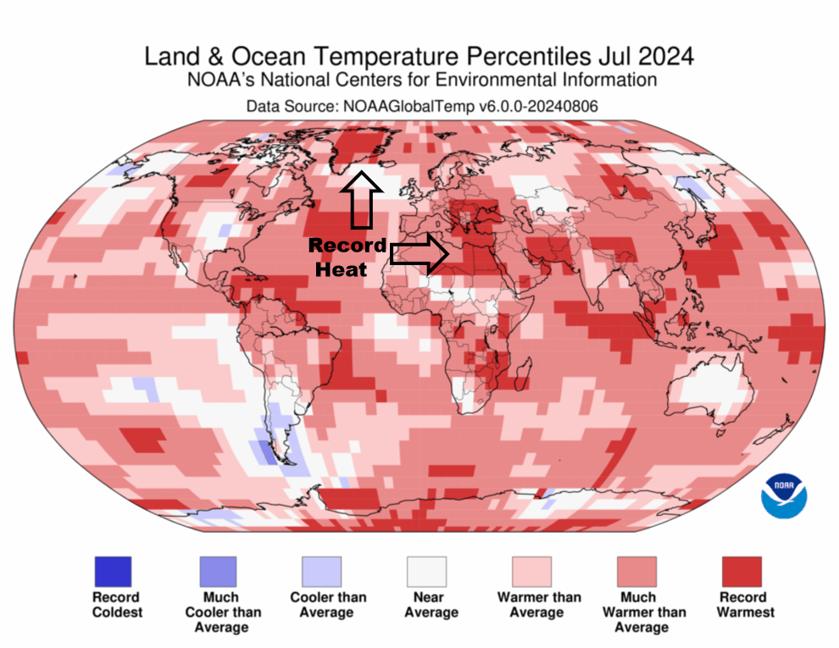
Interpolating Smears Warming Over Places Lacking Data

Slide 8
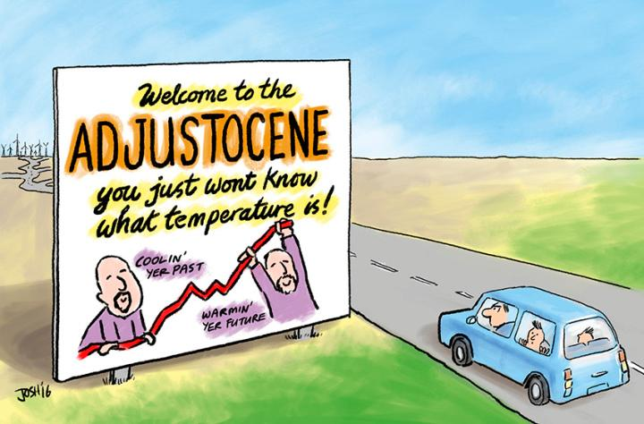

Slide 9
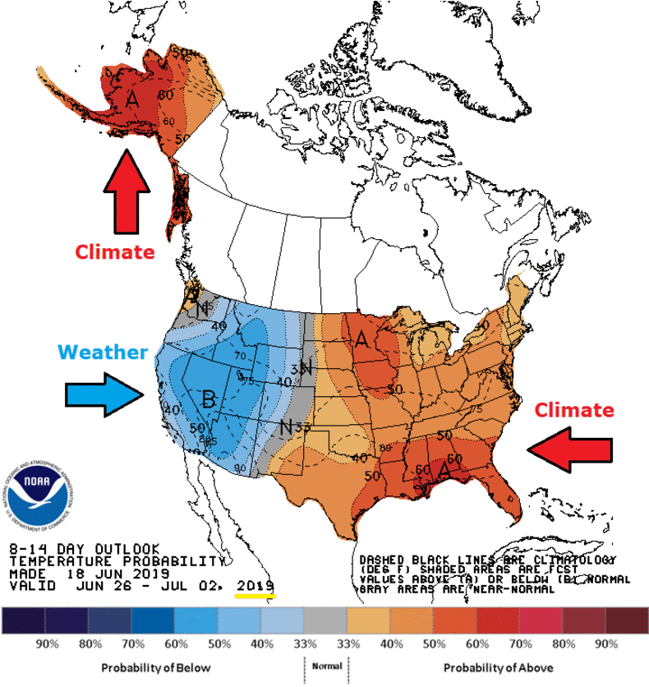
Exaggerated Temperatures and Climate Extremes
Extreme Event Attribution (EEA) Studies are Biased Hot

Slide 10
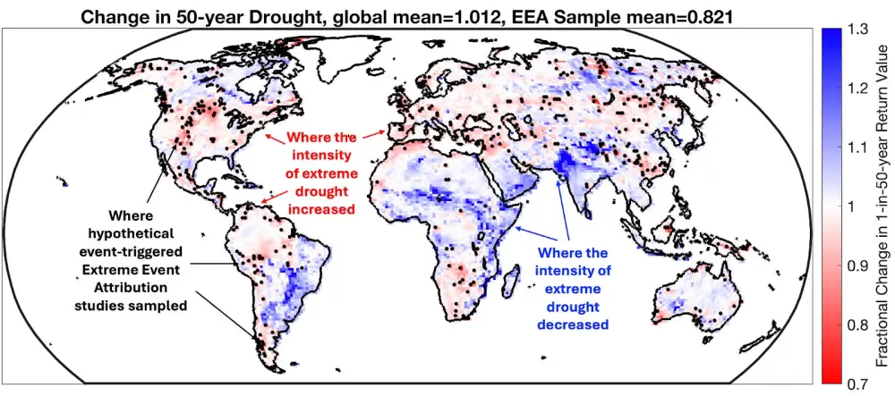
Extremes are Studied and Beneficial Events Ignored
The map shows changes in the magnitude of extreme drought under climate change according to the highly-regarded NCAR CESM2 Climate Model. Overall, this model simulates that warming decreases the frequency and intensity of extreme drought in more locations than it increases. The black dots show EEA studies overwhelmingly sample areas where droughts are getting more intense and more frequent. Just relying on the EEA sample gives an incorrect impression not only on the magnitude of change in extreme droughts but also on the sign of the direction of change!

Slide 11
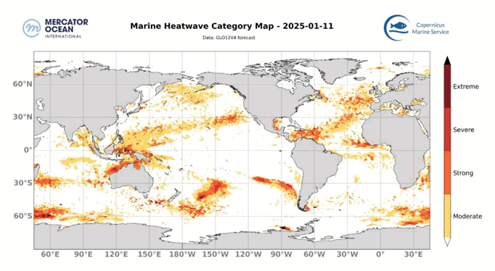

Claim: As climate change causes our planet to warm, marine heatwaves are becoming more frequent, more intense, and longer lasting.
“Regions of high SST and low-level convergence follow the Sun. As the Sun moves away from a convective region, the strong trade winds set in, and the evaporative cooling enhances, resulting in a net cooling of the surface. We conclude that the evaporative cooling associated with the seasonal and interannual variations of trade winds is one of the major factors that modulate the SST distribution of the Pacific warm pool.”
Animation shows locations of moderate to severe MHWs mid-month 2025 January to October. A marine heatwave is defined as one where the measured temperature is within 10% of the maximum values observed (i.e., above the Threshold (90th quantile) , for at least 5 consecutive days. For this, the intensity is compared to the difference between the climatological mean and the 90th percentile value (threshold).

