Slide 1
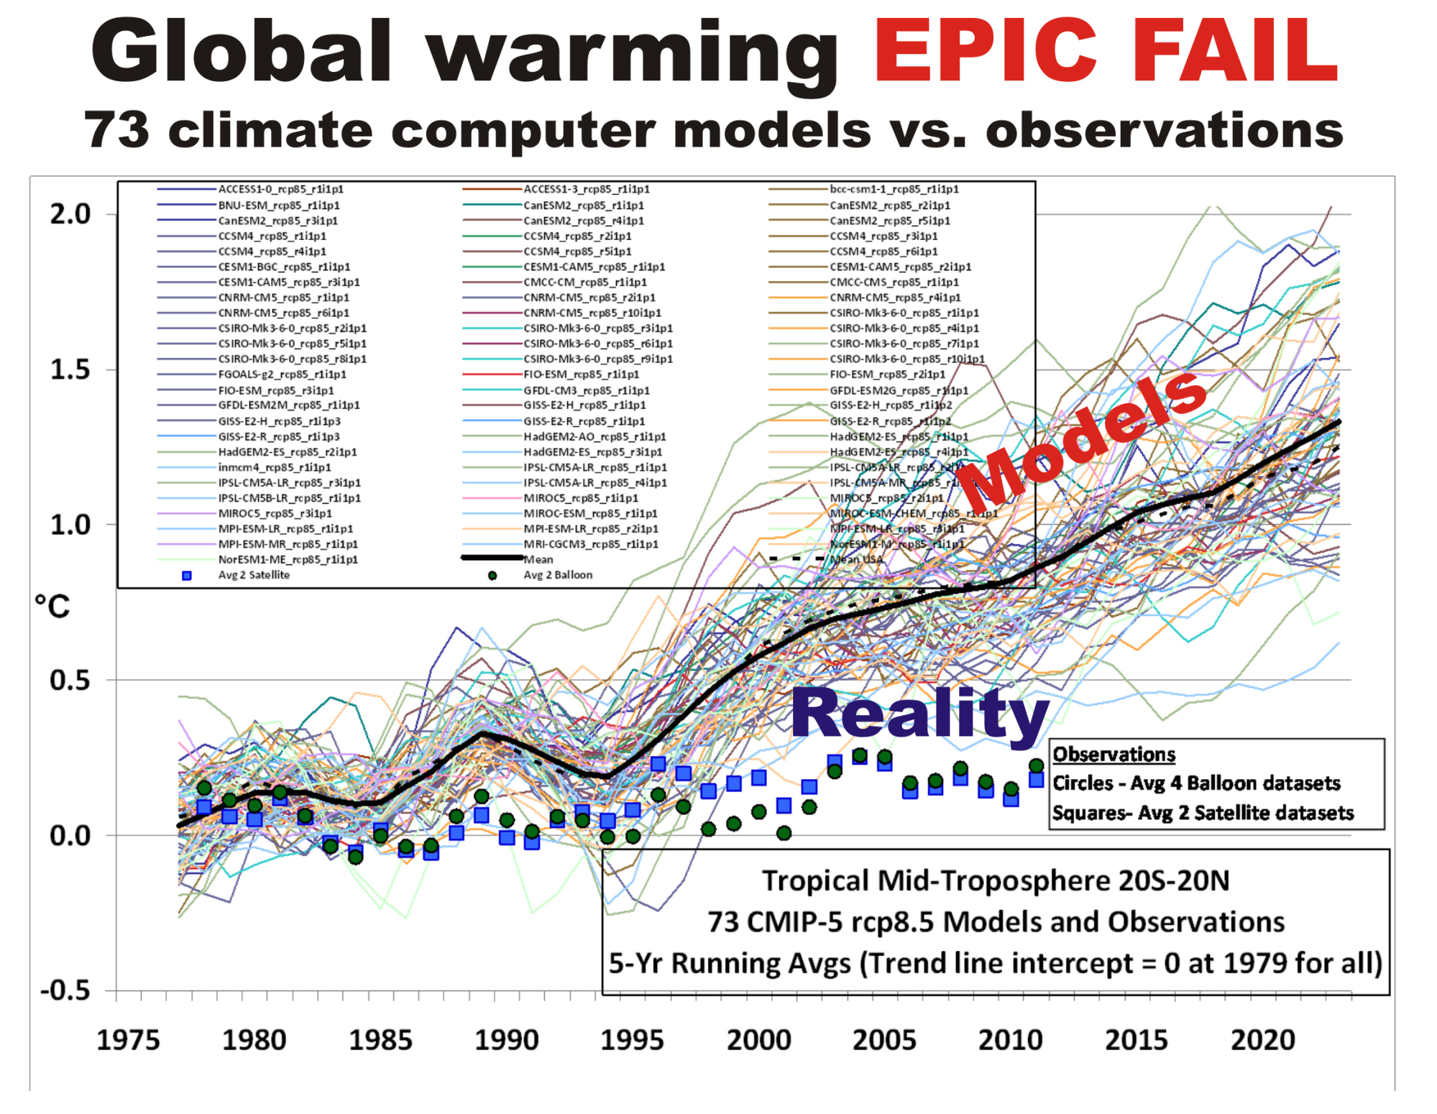
Hot Climate Models Not Fit For Policymaking
1. The observed rate of global warming over the past 50 years has been weaker than that predicted by almost all computerized climate models.
2. Climate models that guide energy policy do not even conserve energy, a necessary condition for any physically based model of the climate system.
3. Public policy should be based on climate observations—which are rather unremarkable—rather than climate models that exaggerate climate impacts.

Slide 2
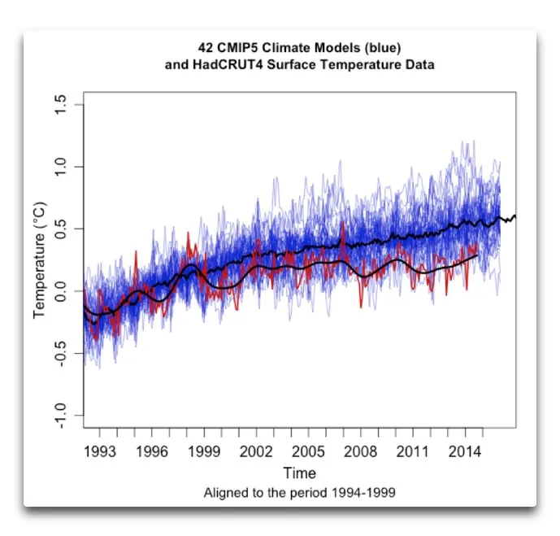
Temperatures According to Climate Models Test Case
In 2015 at WUWT, Willis Eschenbach posted spreadsheets of temperature results from 42 CMIP5 models used in the IPCC reports, downloaded from KNMI website. RCP 4.5 was used by all to cover the period from 1861 to 2100.
I was one of those who responded to his invitation to analyze them and report findings.
The full post is at my blog:
Temperatures According to Climate Models. Highlights are as follows.

Slide 3
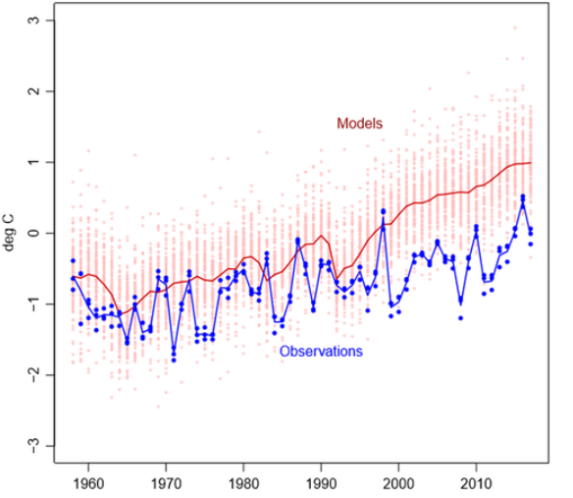
Models Wrong About the Past Produce Unbelievable Futures
Of the 102 model runs considered by Christy and McKitrick, only INM-CM4 model produced by the Institute for Numerical Mathematics of the Russian Academy of Sciences (Volodin and Gritsun, 2018). That model projects only 1.4°C warming by the end of the century, only one-third as much as the IPCC forecasts.
(1) INM-CM4 has the lowest CO2 forcing response at 4.1K for 4xCO2. That is 37% lower than multi-model mean.
(2) INM-CM4 has by far the highest climate system inertia: Deep ocean heat capacity in INM-CM4 is 317 W yr m-2 K -1 , 200% of the mean (which excluded INM-CM4 because it was such an outlier).
(3) INM-CM4 exactly matches observed atmospheric H2O content in lower troposphere (215 hPa), and is biased low above that. Most others are biased high.

Slide 4
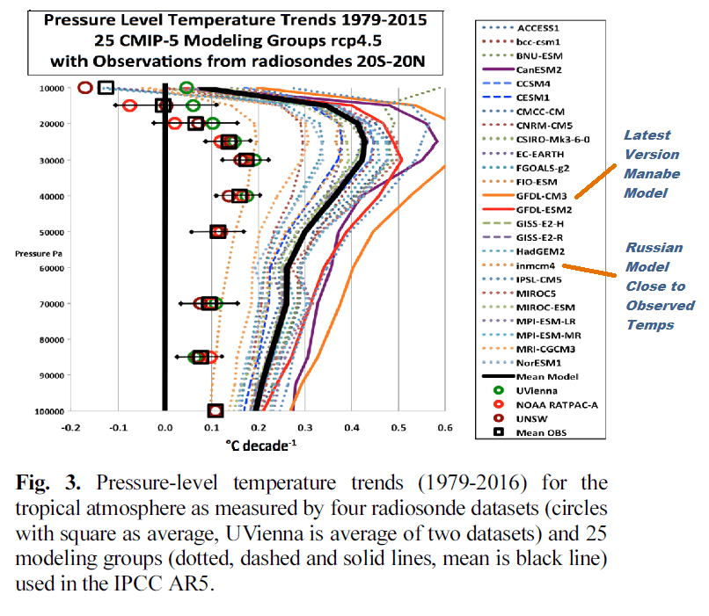
Best Model vs. Nobel Prize Manabe Model vs. Observations
At its worst, the GFDL model is predicting approximately five times as much warming as has been observed since the upper-atmospheric data became comprehensive in 1979. This is the most evolved version of the model that won Manabe the Nobel.
In the CMIP-5 model suite, there is one, and only one, that works. It is the model INM-CM4 from the Russian Institute for Numerical Modelling, and the lead author is Evgeny Volodin. It seems that Volodin would be much more deserving of the Nobel for, in the words of the committee “reliably predicting global warming.”

Slide 5
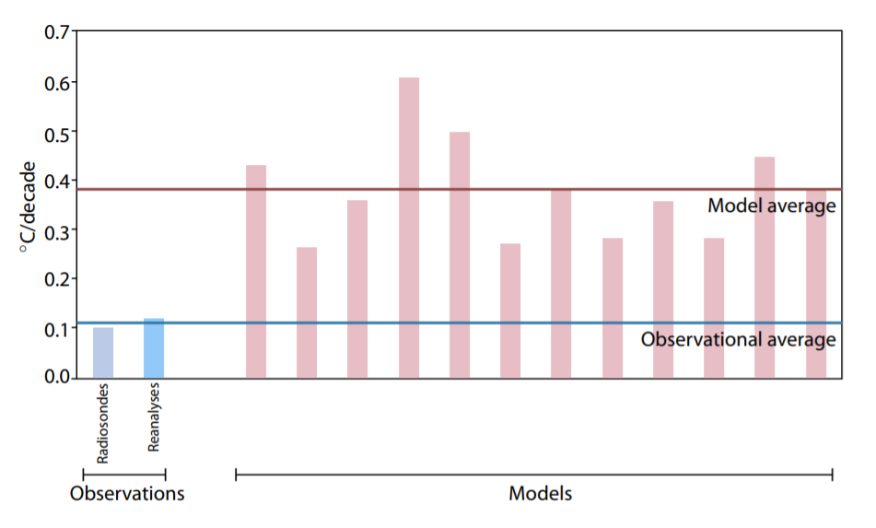
New CMIP-6 Models Run Even Hotter Than Observations
The CMIP6 models, in pink, are also warming faster than the real world. They actually have a higher sensitivity than the CMIP5 models; in other words, they’re apparently getting worse! This is a big problem.
The range of ECS values across models has widened in CMIP6, particularly on the high end. This ECS increase is primarily attributable to strengthened positive cloud feedbacks, as all noncloud feedbacks are essentially unchanged on average in CMIP6.
However, it is the unique combination of weak overall negative feedback and moderate radiative forcing that allows several CMIP6 models to achieve high ECS values beyond the CMIP5 range.
Figure 8: Warming in the tropical troposphere according to the CMIP6 models. Trends 1979–2014 (except the rightmost model, which is to 2007), for 20°N–20°S, 300–200 hPa.

Slide 6
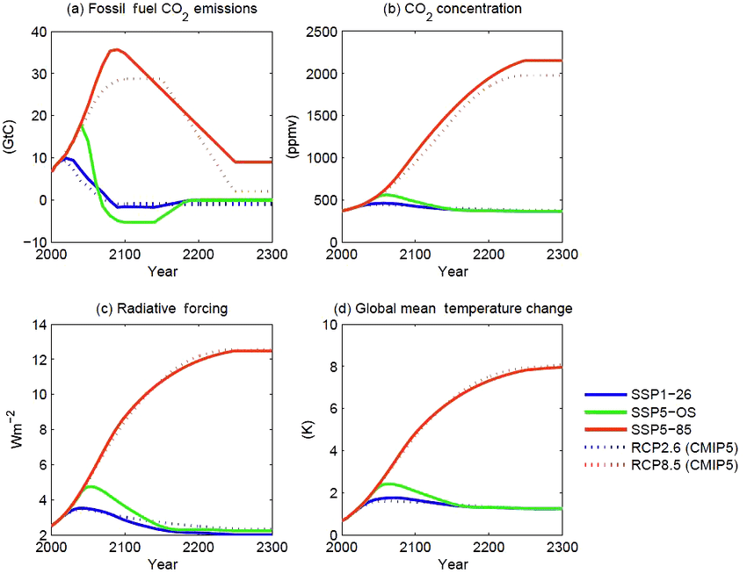
IPCC Scenarios Ensure Models Unreal Climate Forecasts
The scenarios are important since they stipulate data inputs the model must accept as conditions for producing forecasts according to a particular scenario (set of assumptions). The document with complete details is The Scenario Model Intercomparison Project (ScenarioMIP) for CMIP6.
As shown, the SSP1-26 is virtually the same scenario as the former RCP2.6, while SSP5-85 is virtually the same as RCP8.5, the wildly improbable scenario (impossible according to some analysts). Note that FF CO2 emissions are assumed to quadruple in the next 80 years, with atmospheric CO2 rising from 400 to 1000 ppm ( +150%).
Figure 5. CO2 emissions (a) and concentrations (b), anthropogenic radiative forcing (c), and global mean temperature change (d) for the three long-term extensions.

Slide 7
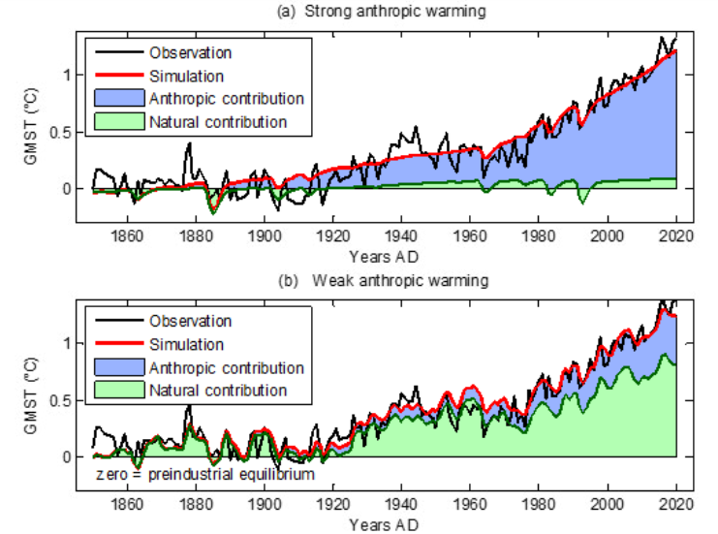
Climate Models Limited by Denying Natural Forcings
In both cases, the overall result for the global temperature simulation (red) fits fairly well with the observations (black). Curves also show the forcing contributions to modern warming (since 1850). From this perspective, the natural (green) and anthropogenic (blue) contributions are in strong contradiction between panels (a) and (b). This incompatibility is at the heart of our work.
In a set of consistent climate series solar activity appears to be the main driver of climate change. To eradicate this hypothesis, the anthropogenic principle requires four simultaneous unfounded assessments:
♦ A strong anthropogenic forcing, able to account for all of the current warming.
♦ A low solar forcing.
♦ A low internal variability.
♦ The nonexistence of significant pre-industrial climate anomalies, which could indeed be explained by strong solar forcing or high internal variability.
Figure. 1. Anthropgenic and natural contributions. (a) Locked scaling factors, weak Pre Industrial Climate Anomalies (PCA). (b) Free scaling, strong PCA.
De Larminat (2023)

Slide 8
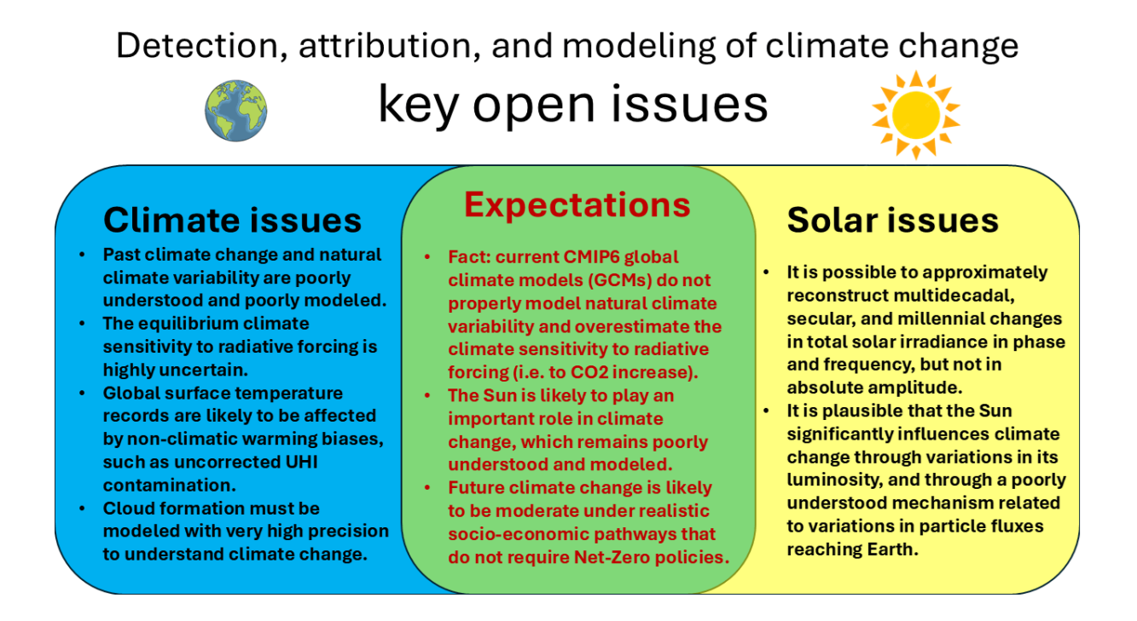
Climate Models Have Many Issues To Become Credible
CMIP GCMs face significant scientific challenges in attributing and modeling climate change, particularly in capturing natural climate variability over multiple timescales throughout the Holocene. Other key concerns include the reliability of global surface temperature records, the accuracy of solar irradiance models, and the robustness of climate sensitivity estimates. Global warming estimates may be overstated due to uncorrected non-climatic biases, and the GCMs may significantly underestimate solar and astronomical influences on climate variations.

