Slide 1
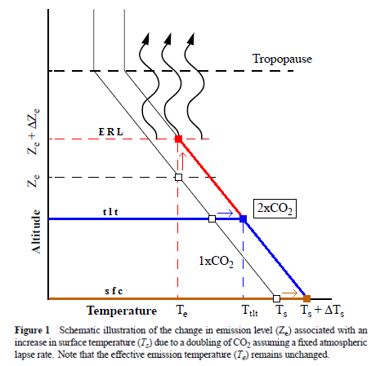
GHG Warming Theory and the Tests It Fails
The hypothetical idea of an “(anthropogenically) enhanced GHE” (the “AGW”) and its supposed mechanism for (CO2-driven) global warming is “the raised ERL (Effective Radiating Level)” – referred to as Ze in the schematic With the excess input of CO2, the ERL is pushed up, and, with that, the temperature at ALL ALTITUDE-SPECIFIC LEVELS of the Earth system is forced to do the same. being directly connected via the so-called environmental lapse rate, i.e. the negative temperature profile rising up through the tropospheric column.

Slide 2
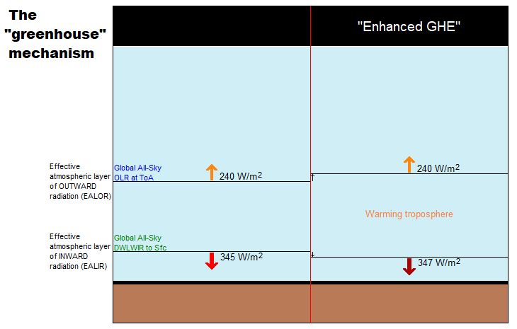
The “Enhanced Greenhouse Effect”
OLR stays flat, while TLT increases significantly and systematically over time;
TLT increases systematically over time, but DWLWIR increases significantly even more. Effectively summed up in this diagram which disregards any solar warming at work for the sake of simplicity.

Slide 3
Three Tests for GHG Warming in the Sky
The null hypothesis in this case would claim or predict that, if there is NO strengthening “greenhouse mechanism” at work in the Earth system, we would observe:
1. The general evolution (beyond short-term, non-thermal noise (like ENSO-related humidity and cloud anomalies or volcanic aerosol anomalies))* of the All-Sky OLR flux at the ToA to track that of Ttropo (e.g. TLT) over time;
2. The general evolution of the All-Sky DWLWIR at the surface to track that of Ttropo (Ts + Ttropo, really) over time;
3. The general evolution of the All-Sky OLR at the ToA and the All-Sky DWLWIR at the surface to track each other over time, barring short-term, non-thermal noise.

Slide 4
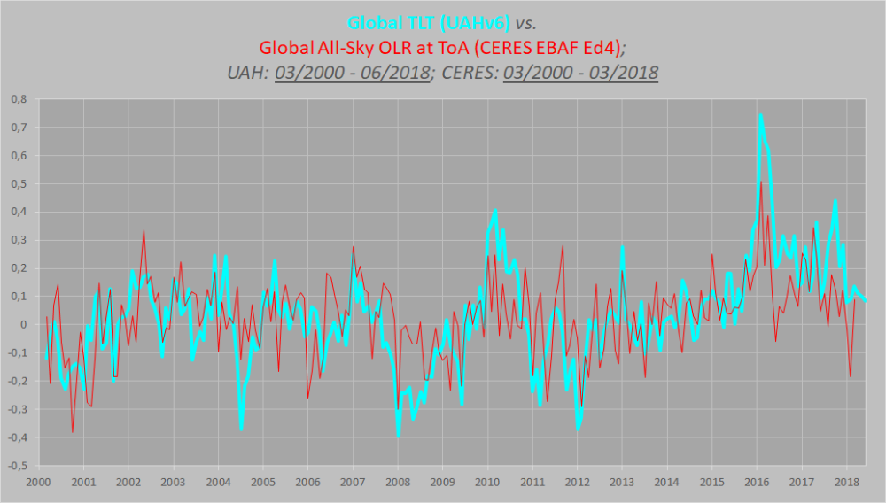
Missing AGW Fingerprint #1
The combined ERBS+CERES OLR record is seen to track the general progression of the UAHv6 TLT series tightly, both in the tropics and near-globally, all the way from 1985 till today. Considering the CERES era alone, this is how the global OLR matches against the global TLT since 2000.

Slide 5
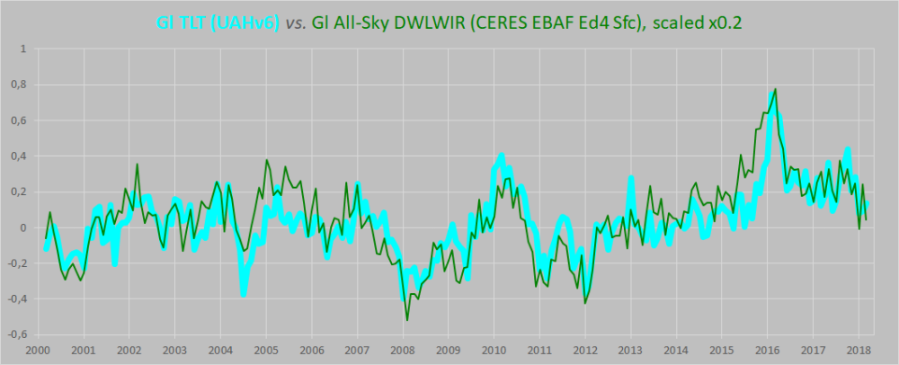
Missing AGW Fingerprint #2
This compares the tropospheric temperatures with the DWLWIRsfc ‘flux’, that is, the apparent atmospheric thermal emission to the surface. No evidence whatsoever of any gradual, systematic rise in DWLWIR over the TLT, going from 2000 to 2018.

Slide 6
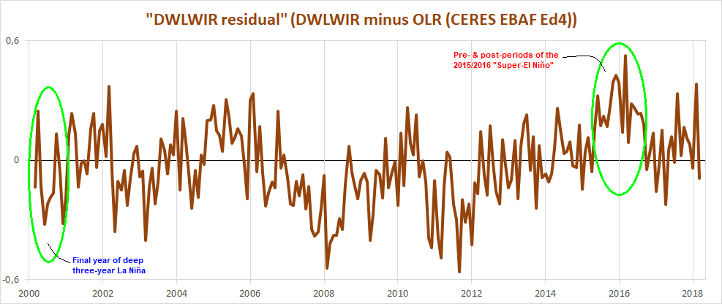
Missing AGW Fingerprint #3
Since neither the OLR at the ToA nor the DWLWIR at the surface deviated meaningfully from the UAHv6 TLT series, we expect that the two CERES ‘flux products’ also shouldn’t themselves deviate meaningfully overall from one another. And, unsurprisingly, they don’t. Don’t be fooled by the visual impact of that late – obviously ENSO-related – peak, and, in this case, also a definite ENSO-based trough right at the start.

Slide 7
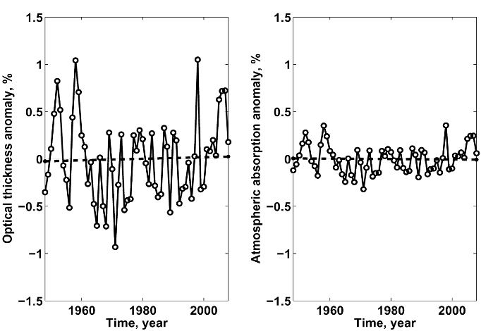
Other Lines of Evidence Against GHG Warming Hypothesis
1. In 2004 Ferenc Miskolczi studied the radiosonde datasets, and found that the optical density at the top of the troposphere does not change with increasing CO2, since reducing H2O maintains optimal radiating efficiency.
Miskolczi’s analysis shows that at present CO2 concentrations, the radiative warming effect is saturated, because the atmospheric heat engine is always striving to maximize the dissipation of surface heat into space.
In the present circumstance, any additional input of heat produces a reaction of additional evaporation or convection to restore the energy balance. Radiative equilibrium is not disturbed, as shown by the stability of the optical depth in the upper troposphere.

Slide 8
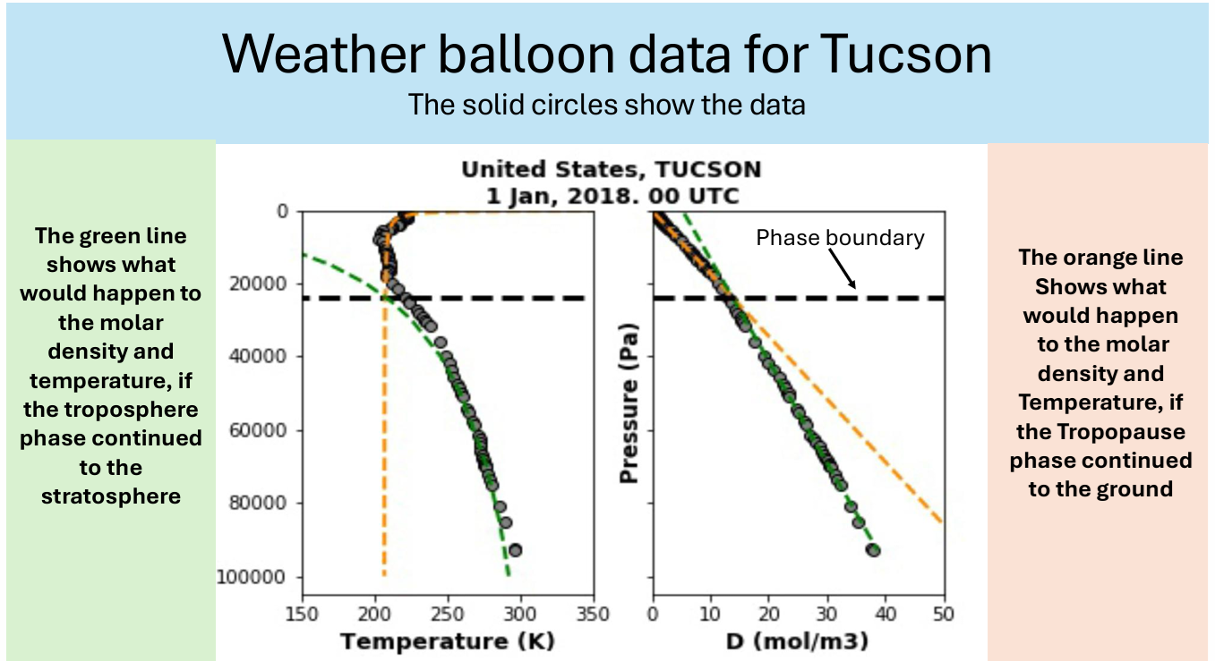
Other Lines of Evidence Against GHG Warming Hypothesis
2. Ronan and Michael Connolly studied radiosonde data and concluded in 2014:
When we analysed the barometric temperature profiles of the radiosondes in this paper, we were unable to detect any influence from greenhouse gases. Instead, the profiles were very well described by the thermodynamic properties of the main atmospheric gases, i.e., N 2 and O 2 , in a gravitational field.” The magnitude of the greenhouse effect is very small, perhaps negligible, too small to be detected from the archived radiosonde data.”
The key GCM assumption of local thermodynamic equilibrium is contradicted by the weather ballon data. The data from 20 million weather ballons prove that the atmosphere is mostly in thermodynamic equilibrium over the 20 miles from the ground to the statosphere, not just the 1 mile limit of GCMs

Slide 9
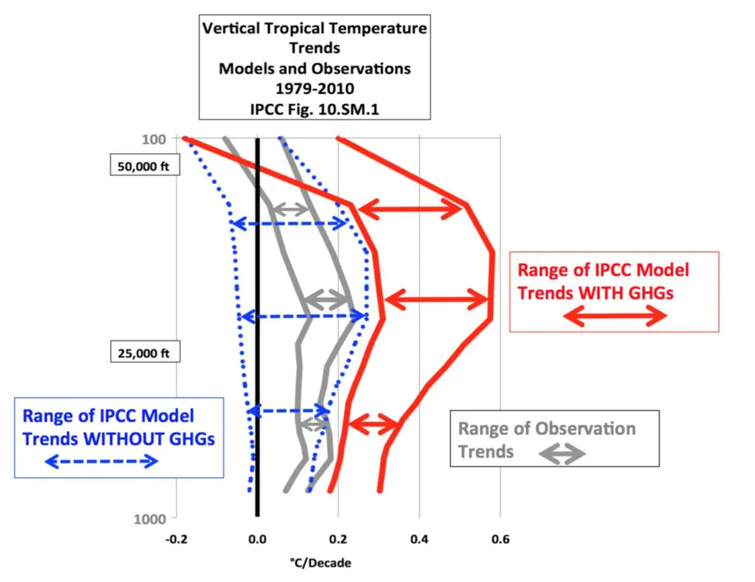
Other Lines of Evidence Against GHG Warming Hypothesis
3. An important proof against the CO2 global warming claim was included in John Christy’s testimony 29 March 2017 at the House Committee on Science, Space and Technology. The text and diagram below are from that document. IPCC Assessment Reports show that the IPCC climate models performed best versus observations when they did not include extra GHGs and this result can be demonstrated with a statistical model as well.
Figure 5. Simplification of IPCC AR5 shown above in Fig. 4. The gray lines are the bounds for the range of observations, the blue for the range of IPCC model results without extra GHGs and the red for IPCC model results with extra GHGs. Displayed is the lack of overlap between the GHG model results (red) and the observations (gray). The nonGHG model runs (blue) overlap the observations almost completely.

Slide 10
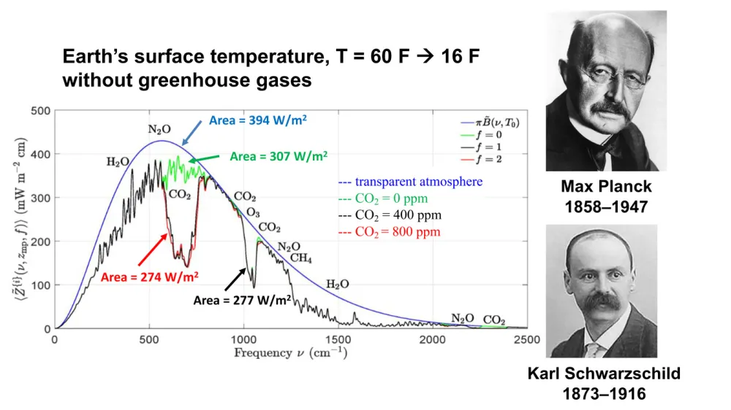
Other Lines of Evidence Against GHG Warming Hypothesis
4. Finding from William Happer that additional CO2 (from any and all sources)
shows negligible effect in the radiative profile of the atmosphere.
The black line is CO2 infrared absorption at 400 ppm, compared to the red line of CO2 IR absorption at 800 ppm. If you double the amount of CO2, you don’t double the size of that gap. You just go from the black curve to the red curve, and you can barely see the difference.

