Slide 1


Part 2: Being Reasonable About Climate Change
Notes from a Curious Generalist
Introducing highlights from an accidental blog with 3400 posts since 2015 on science-related issues. Ron Clutz
rclutz.com

Slide 2
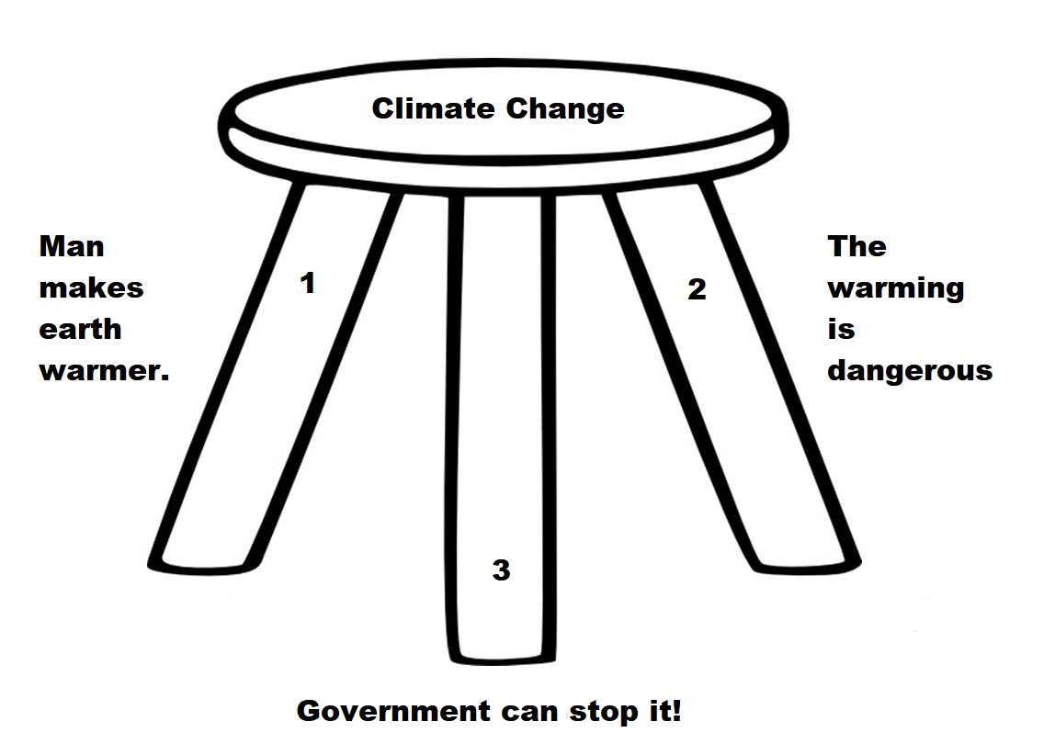
Climate Change is a three-legged stool.
The claim falls when any premise fails.

Slide 3
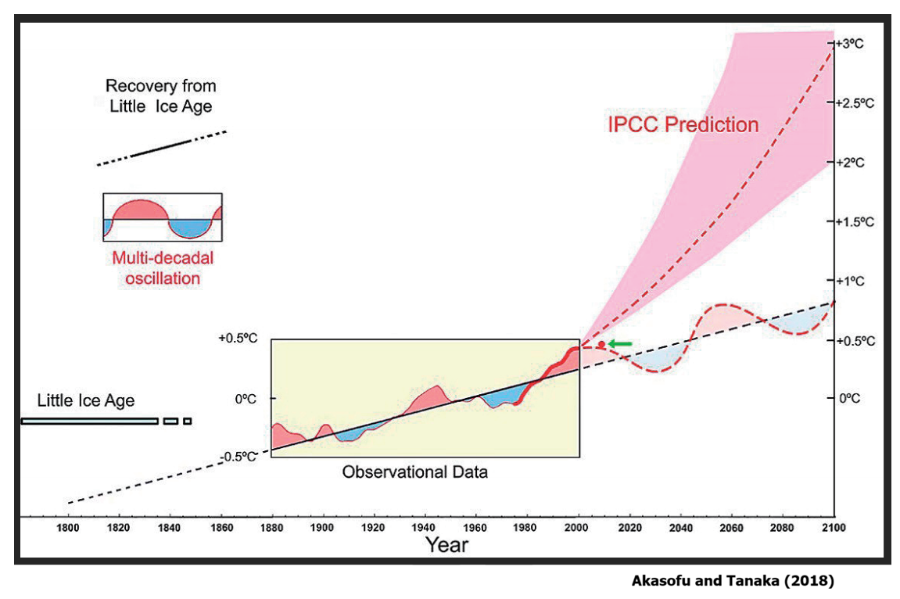
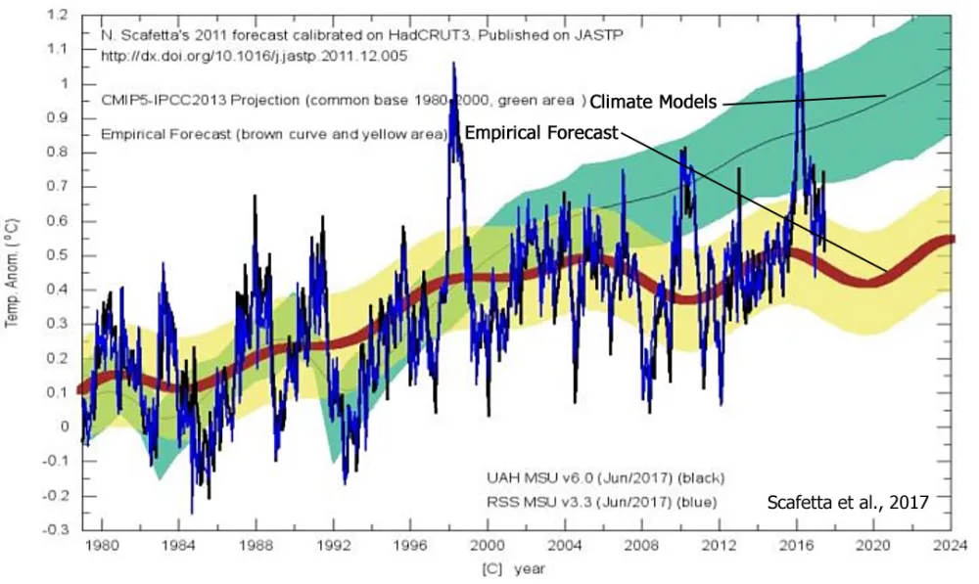
Yes, There’s Been Some Warming,
But Should We Be Worried?
Since the LIA, Global Warming consists of two natural components: A steady rise of 0.8C over 140 years with an overlay of Multi-Decadal Oscillations.
The Warming pattern also compares to a climate system mostly made of a set of complex cycles that mirror astronomical cycles.

Slide 4
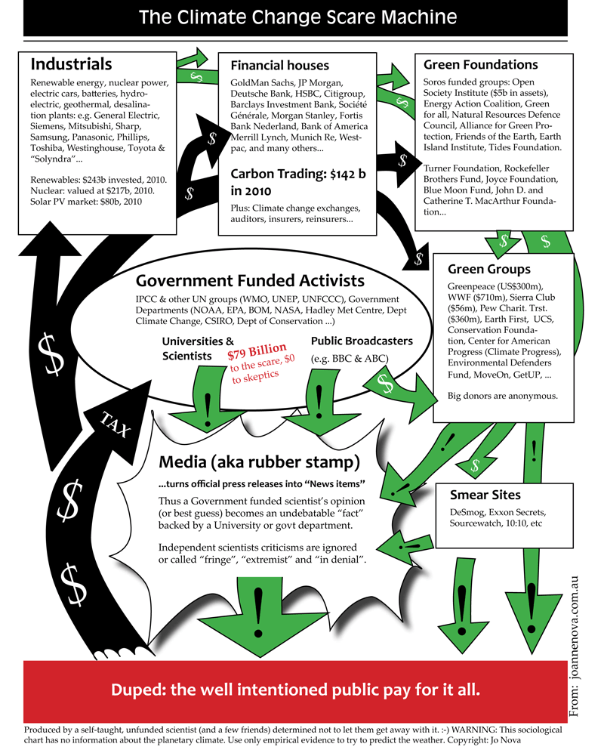
The Climate Change Scare Machine
Climate Change Scare Machine Cycle: How your tax dollars are converted into alarming messages. from Jo Nova in 2010 dollars. Climate Change Business Journal (CCBJ) released its Q3 2025 edition, assessing the $3.4 trillion global climate change industry. Highlights:
1) Size & momentum of the CCI: In 2024, rapid expansion in solar, wind, and EVs. U.S. accounts for $511 billion (15%) of total $3.404 trillion.
2) Segments US share: Carbon Capture & Storage (U.S. 81% of global), Adaptation & Resilience (35%), Research/C&E (35%), Efficiency Tech/Services (24%), Green Buildings (20%), Energy Storage (20%), Low-Carbon Power (9%), Transportation (14%), Carbon Markets (6%).
3) Global electricity generation by Wind and Solar:
Solar industry: $465.6B global, $38.3B U.S.
Wind industry: $253.9B global, $25.6B U.S.
(Not Included: Cost of Governmental climate bureaucracies)

Slide 5

The Scares Ensure Public Support For Funding Climate Initiatives
The Joys of Climate Whack-a-Mole
#1: Temperatures According to Climate Models, failed both hindcasting and forecasting.
Data vs. Models #2: Droughts and Floods, deserts or jungles are neither expanding nor shrinking from rainfall.
Data vs. Models #3: Disasters, Trends in normalized data show constant, stabilized patterns in most cases.
Data vs. Models #4: Climates Changing, At 30-years and more the Köppen zones are quite stable.
All topics whacked, but still popping up.
CCN (Climate Crisis Network) recyles coordinated scare topics flooding media to keep hysteria alive. Some of my rebuttals include:

Slide 6
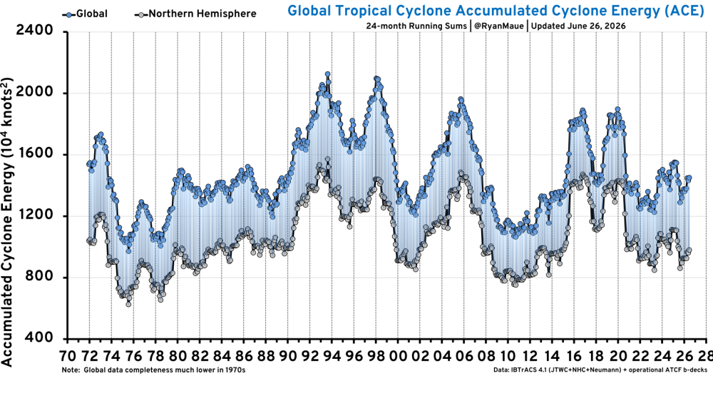
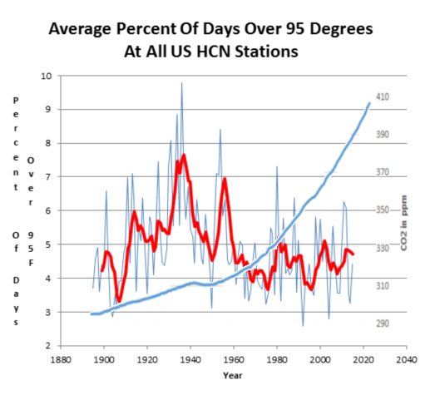
Eleven Empty Climate Claims
Joseph D’Aleo compiled work from experts in the targeted fields.
1. Claim: Heat Waves are increasing at an alarming rate and heat kills.
Fact: They have been decreasing since the 1930s in the U.S. and globally
2. Claim: Global warming is causing more hurricanes and stronger hurricanes.
Fact: Hurricane activity is flat to down since 1900, landfalls in the US are declining.

Slide 7
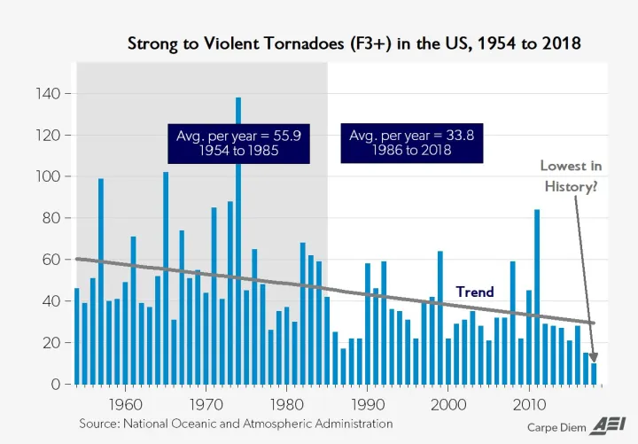
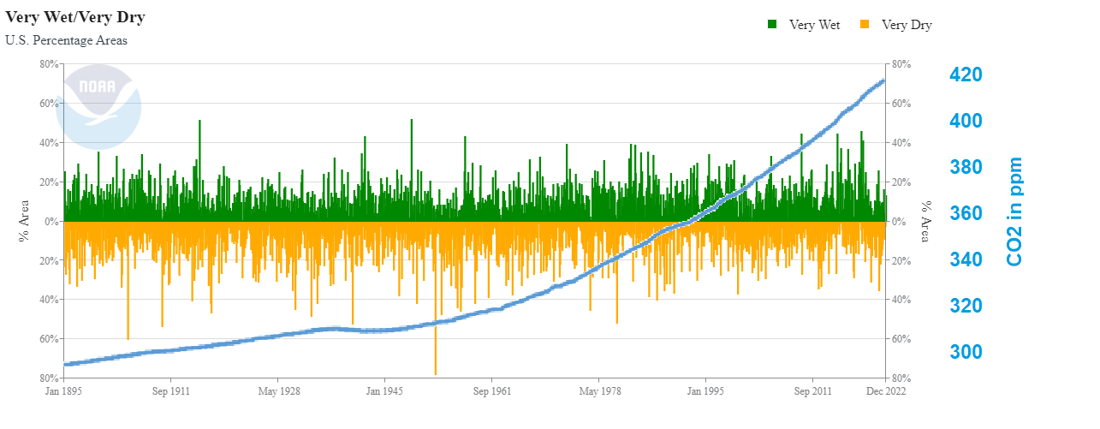
Eleven Empty Climate Claims (cont)
3. Claim: Global warming is causing more and stronger tornadoes.
Fact: The number of strong tornadoes have declined over the last half century
4. Claim: Global warming is increasing the magnitude and frequency of droughts and floods.
Fact: Droughts and floods have not changed since we’ve been using fossil fuels

Slide 8
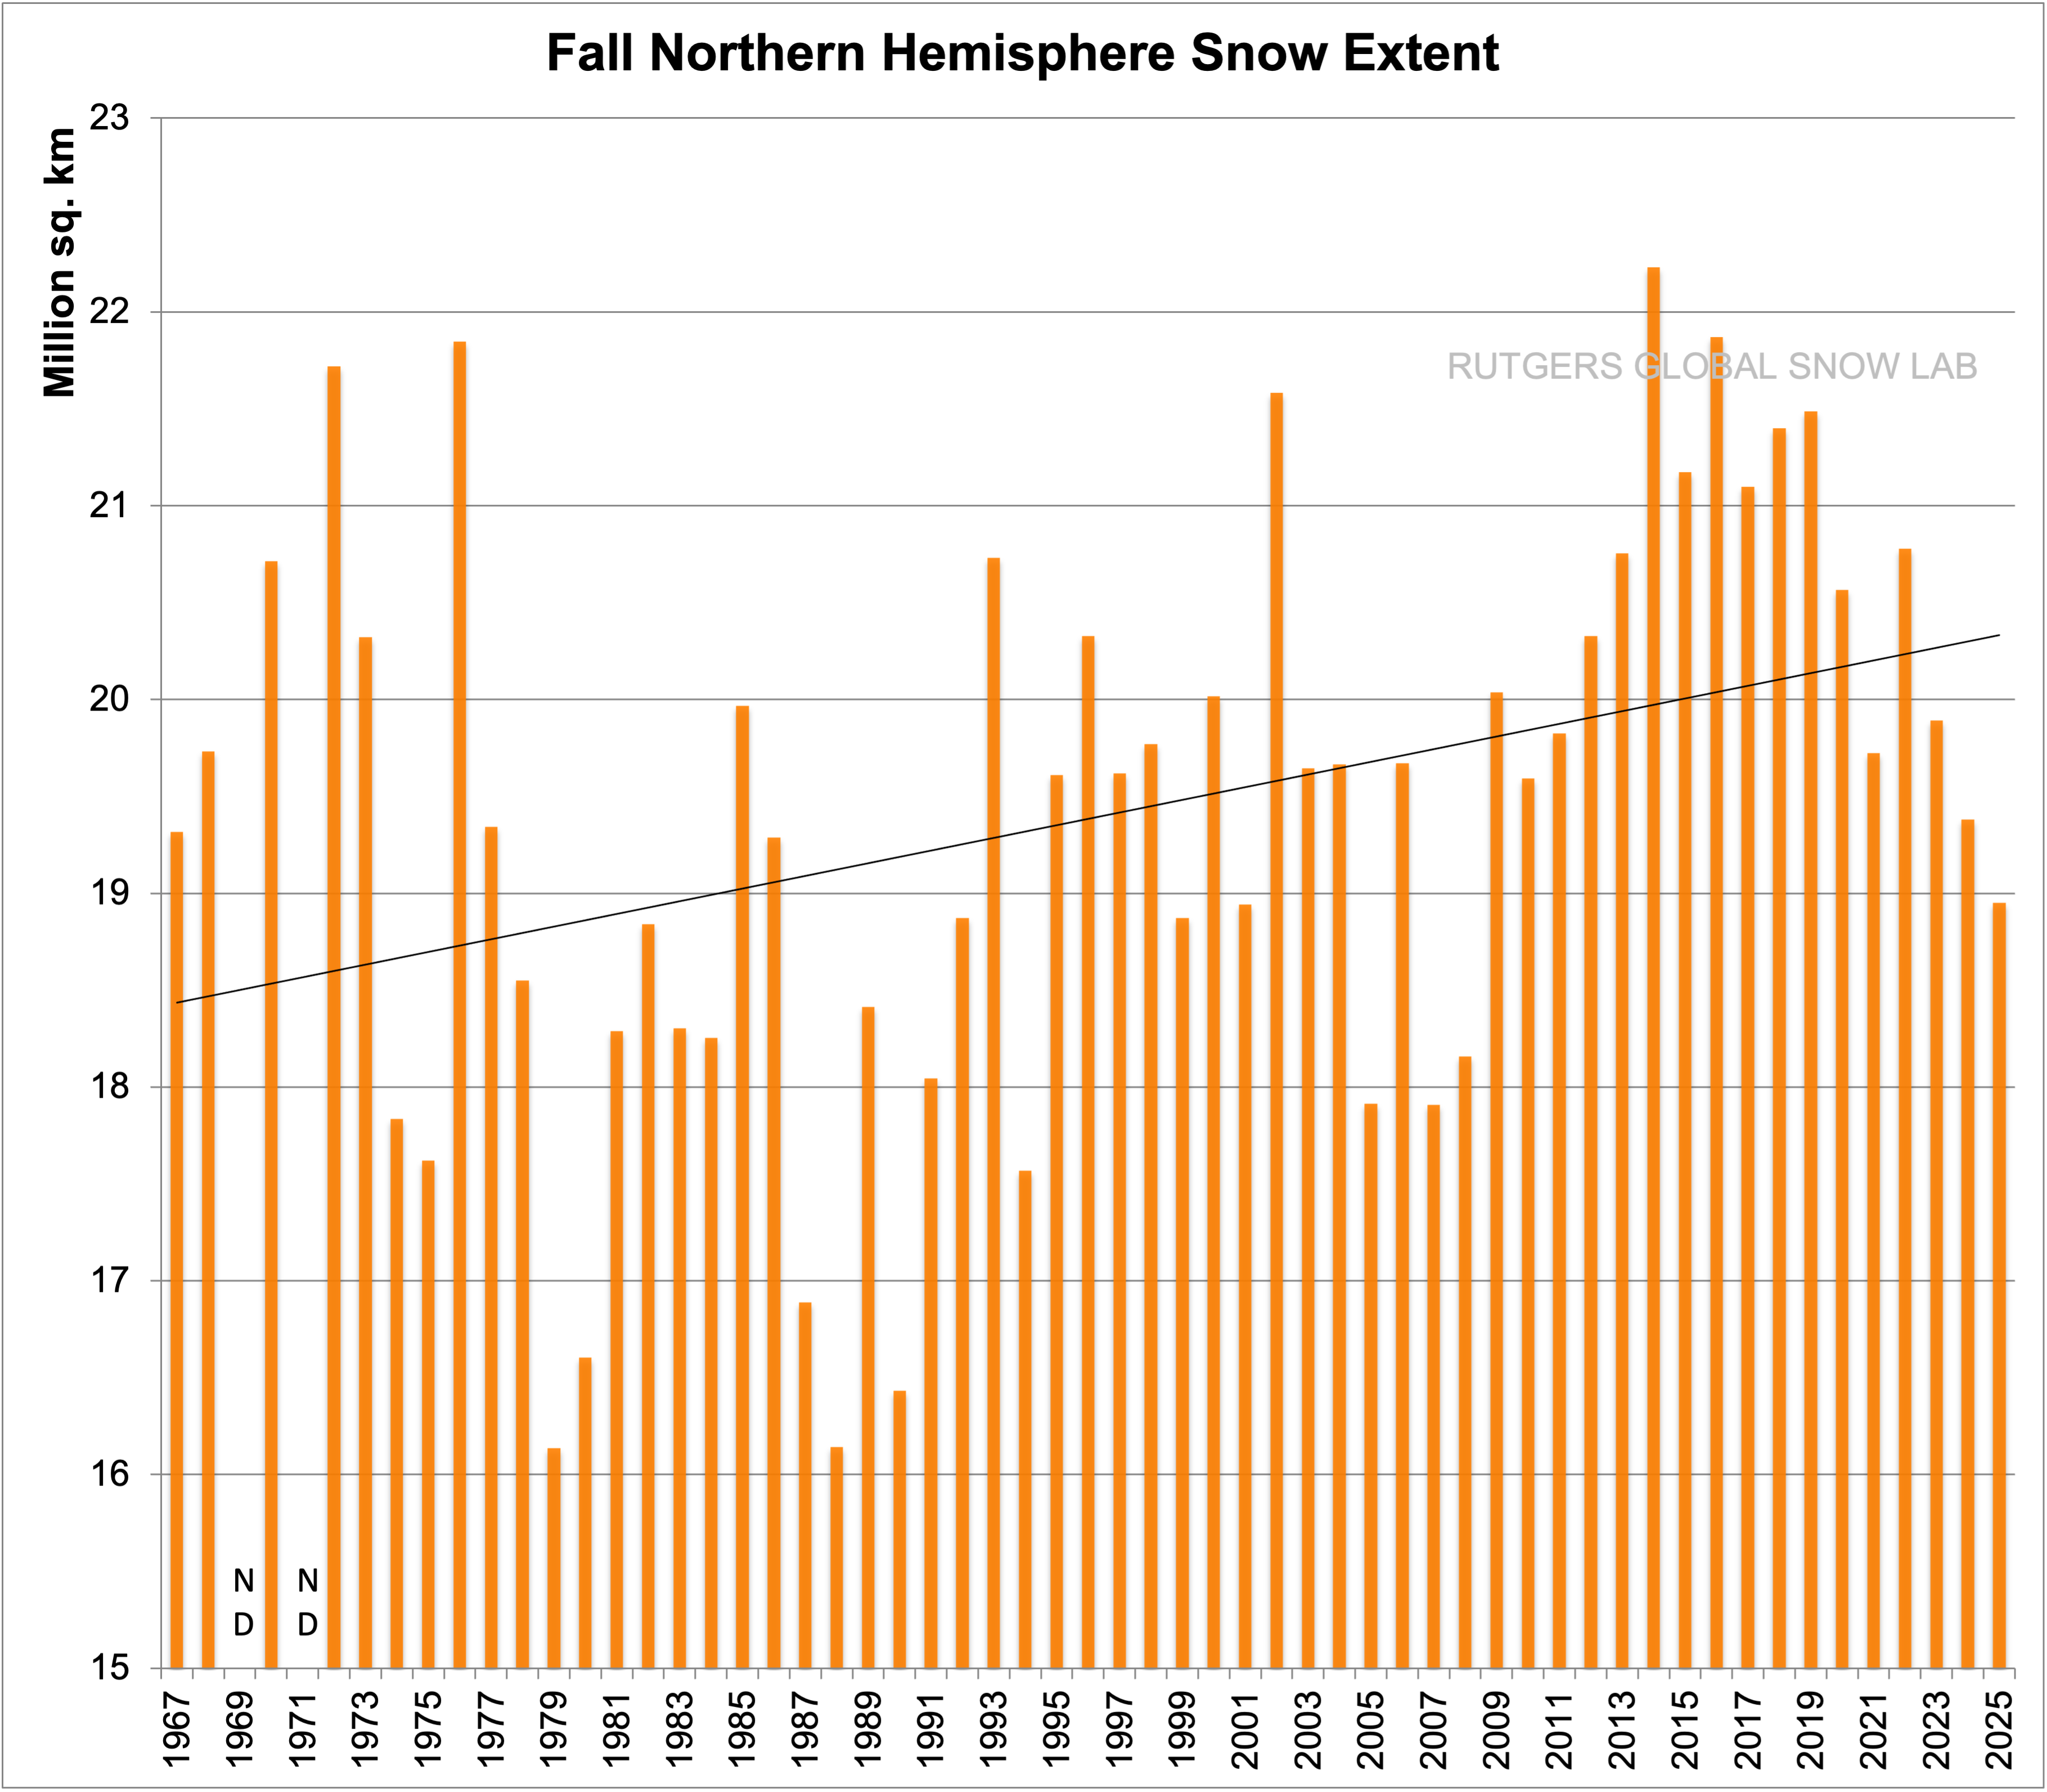
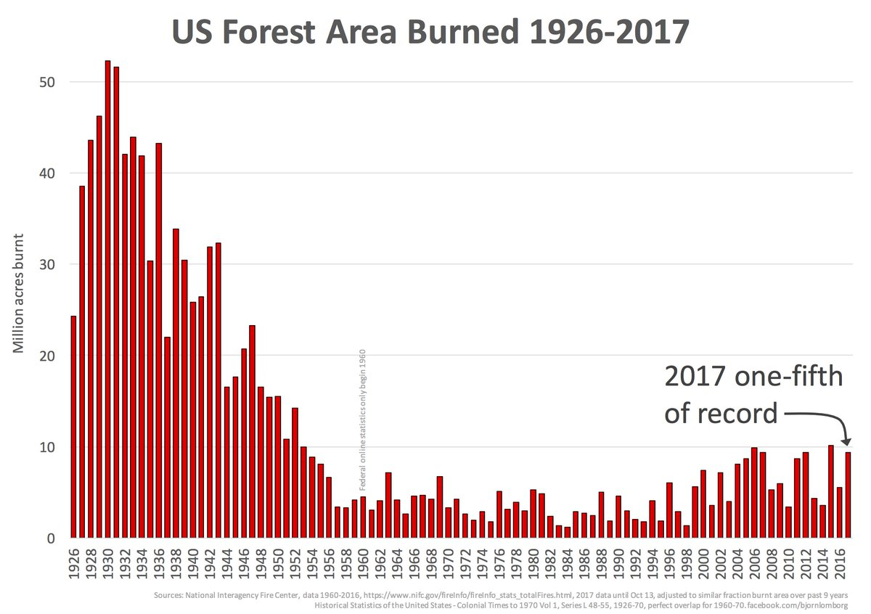
Eleven Empty Climate Claims (cont)
5. Claim: Global Warming has increased U.S. Wildfires.
Fact: Wildfires have been decreasing since 1800s. The increase in damage in recent years is due to population growth in vulnerable areas and poor forest management.
6. Claim: Global warming is causing snow to disappear.
Fact: Snowfall is increasing in the fall and winter in the Northern Hemisphere and North America with many records being set.

Slide 9
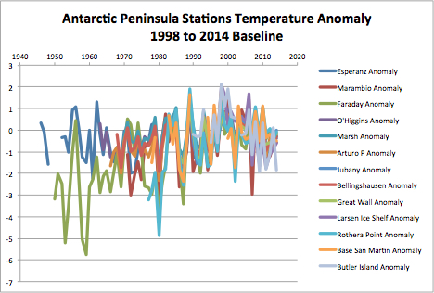
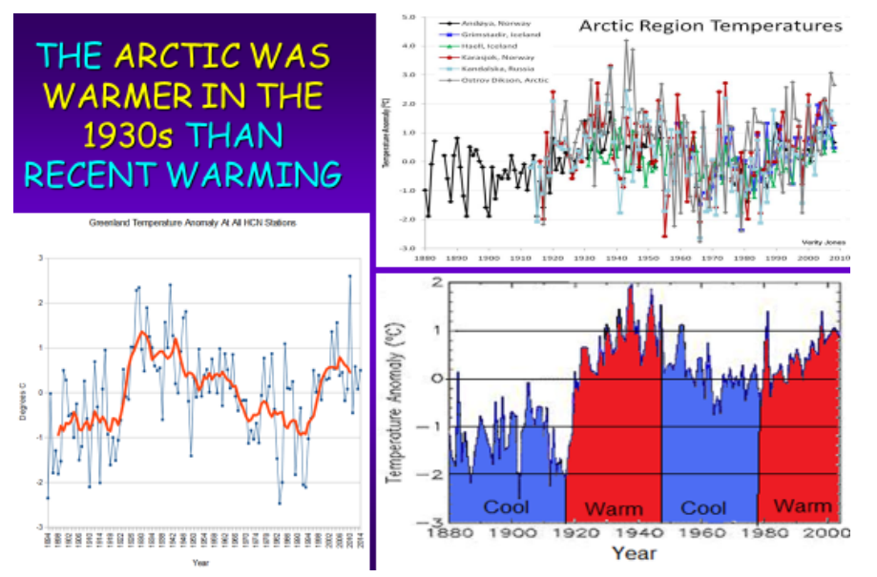
Eleven Empty Climate Claims (cont)
7. Claim: Arctic, Antarctic and Greenland ice loss is accelerating due to global warming.
Fact: The polar ice varies with multidecadal cycles in ocean temperatures. Current levels are comparable to or above historical low levels

Slide 10
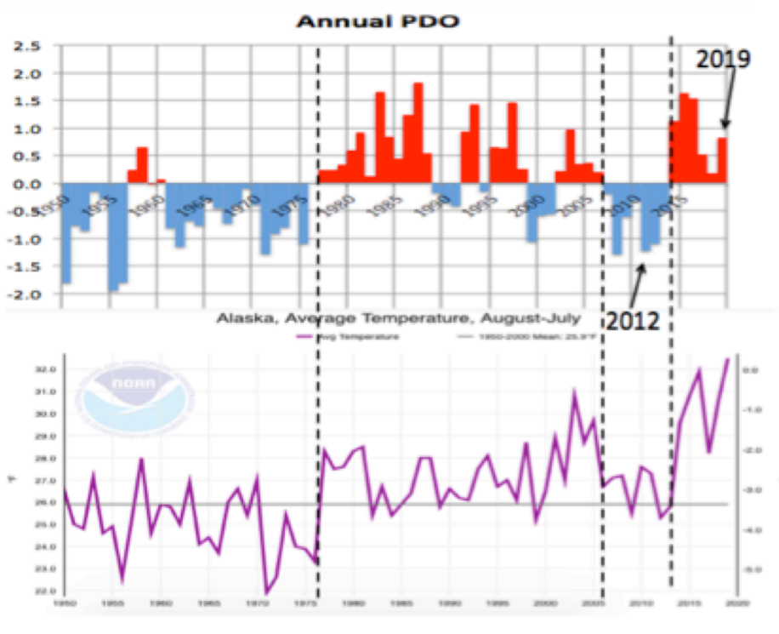
Eleven Empty Climate Claims (cont)
8. Claim: Global warming responsible for record July warmth in Alaska.
Fact: Alaska July 2019 heat records resulted from a warm North Pacific and reduced ice in the Bering Sea late winter due to strong storms. The opposite occurred with record cold in 2012.
Alaska climate (averages and extremes) varies over time but the changes can be explained by natural variability in the North Pacific Ocean, which controls the climate regime in downstream land areas. These ocean temperature regimes (modes of the Pacific Decadal Oscillation or PDO) improve season-­-to-­-season and year-­-to--­year climate forecasts for North America because of its strong tendency for multi-­-season and multi--year persistence. The PDO correlates well with tendencies for El Nino and La Nina, which have a major impact on Alaska and much of North America. Clearly, Global warming is not responsible for record warmth in Alaska.

Slide 11
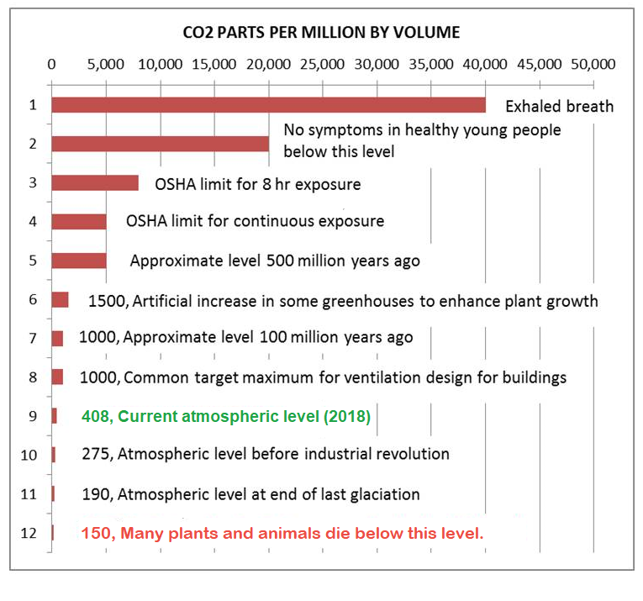
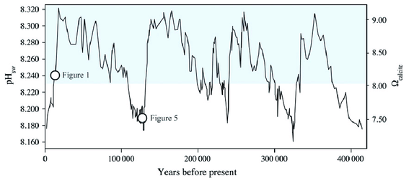
Eleven Empty Climate Claims (cont)
9. Claim: Rising atmospheric CO2 concentrations are causing ocean acidification, which is catastrophically harming marine life.
Fact: When life is considered, an ocean less alkaline is often found to be a non-problem, or even a benefit. (pH 7 is neutral)
10. Claim: Carbon pollution is a health hazard.
Fact: Carbon dioxide (CO2) is an odorless invisible trace gas that is plant food and it is essential to life on the planet. It is not a pollutant

Slide 12
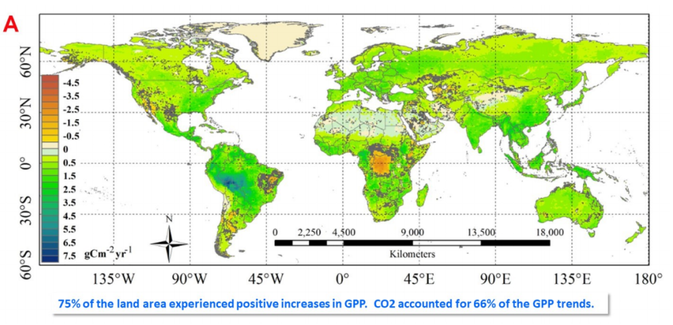
Eleven Empty Climate Claims (cont)
11. Claim: CO2-induced climate change is threatening global food production and harming natural ecosystems.
Fact: The vitality of global vegetation in both managed and unmanaged ecosystems is better off now than it was a hundred years ago, 50 years ago, or even a mere two-to-three decades ago thanks in part to CO2.
Source for Detailed References:
ACRESEARCH
Climate Alarmist
Claim Rebuttals

