Slide 1
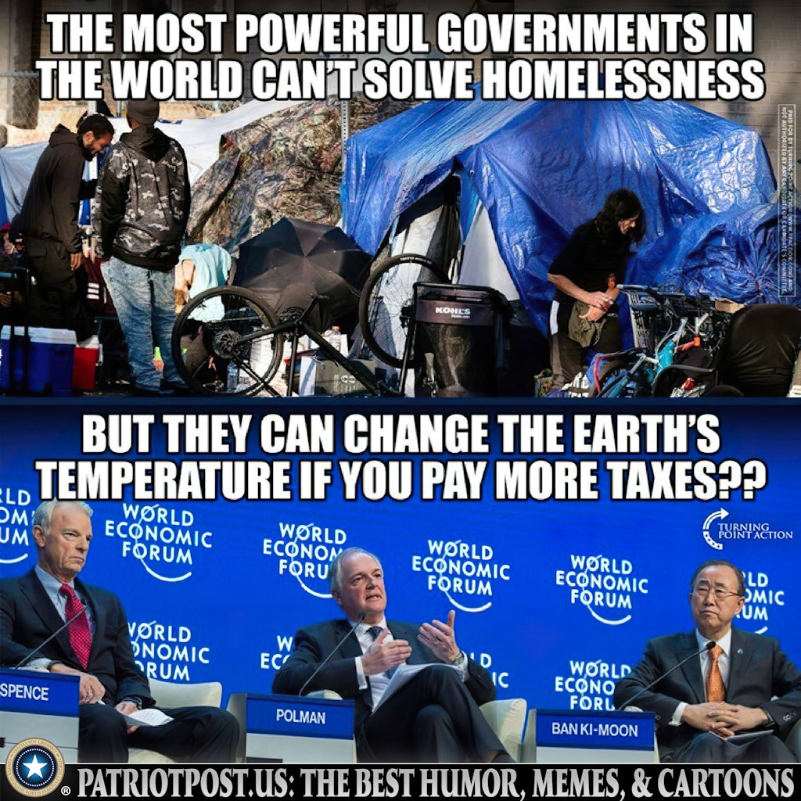
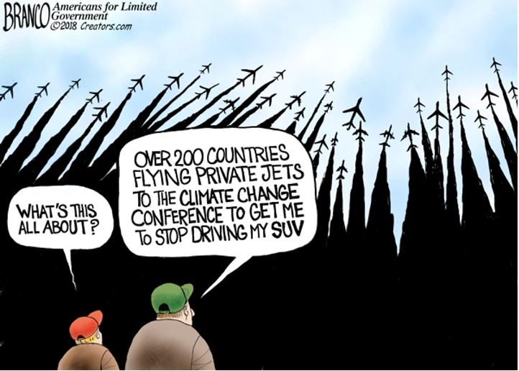
Government Climate Initiatives Intend to Stop Climate Change

Slide 2
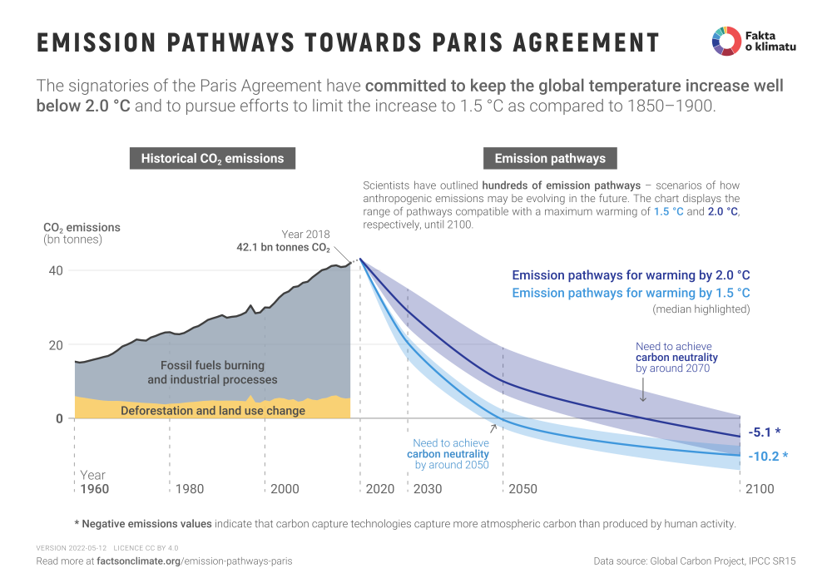
Climate Initiatives: Transition to Carbon Free Energy

Slide 3
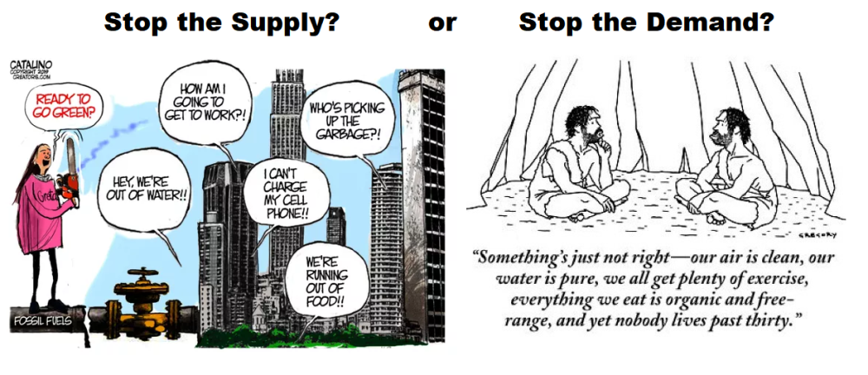
How Do You Want Your Energy ‘Transition’?

Slide 4
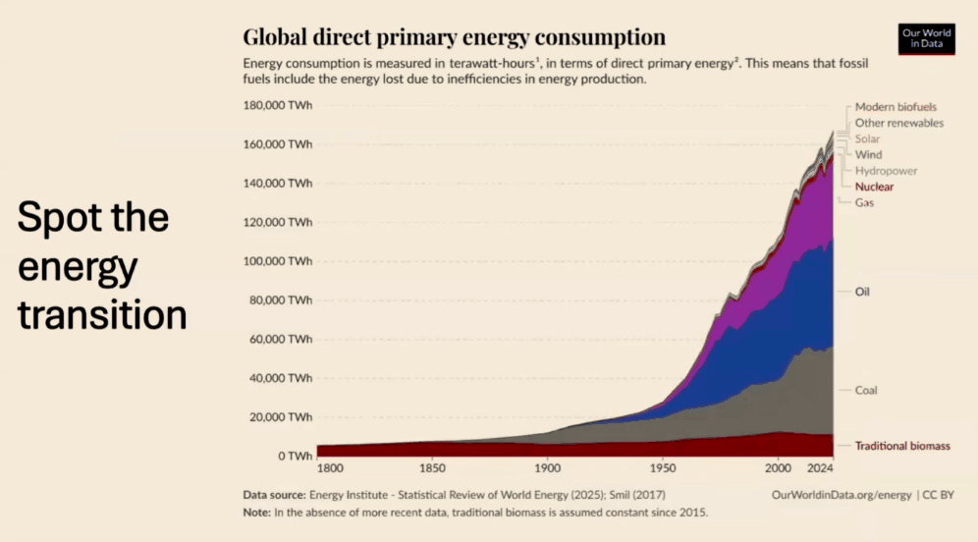
Demand For Reliable Affordable Energy Keeps Increasing

Slide 5

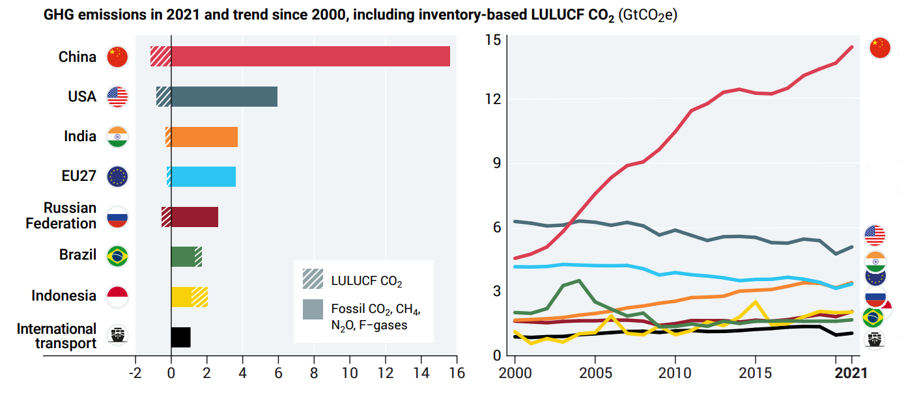
Past Performance Points to Future Behavior

Slide 6
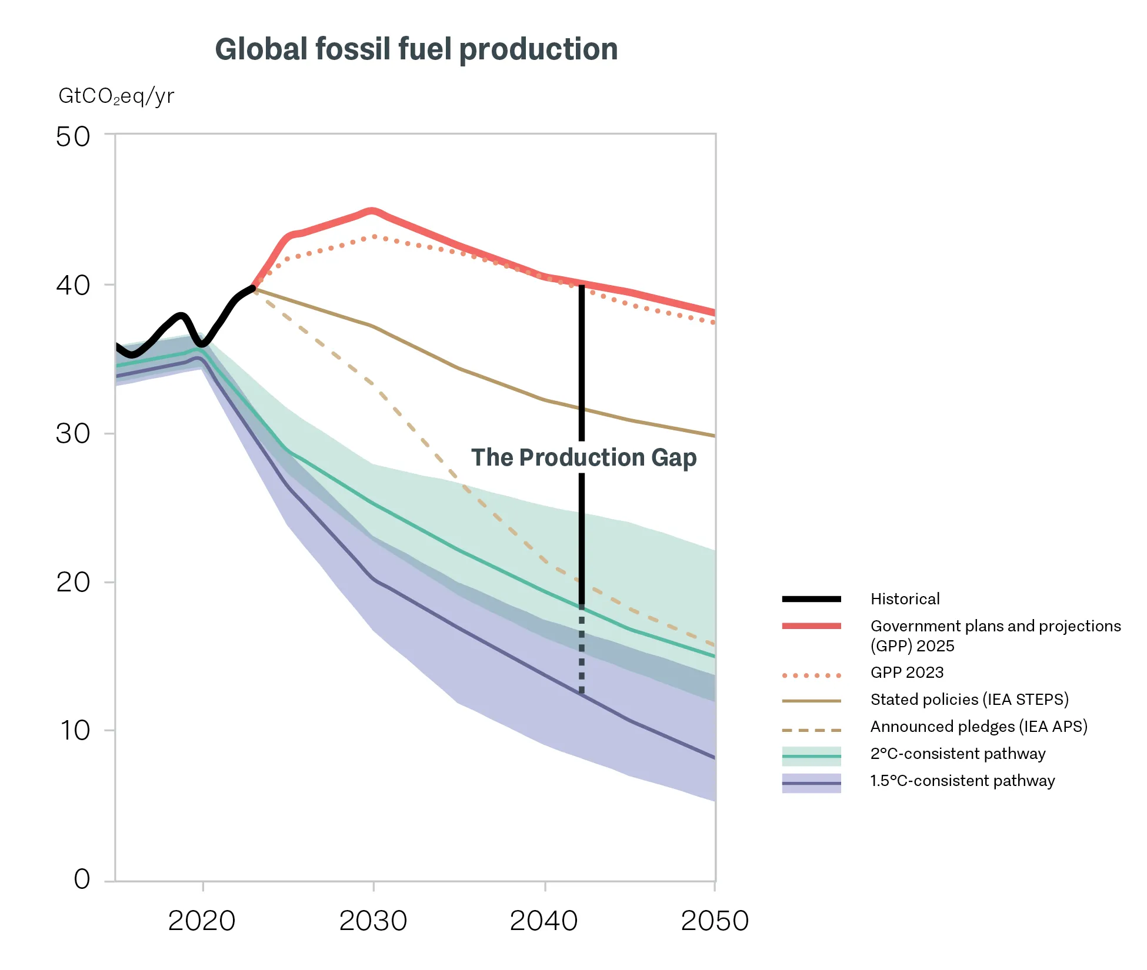
Governments Planning to Produce More Hydrocarbon Fuel
“Projected 2030 production exceeds levels aligned with limiting warming to 1.5ºC by more than 120%. To be consistent with limiting warming to 1.5ºC and reaching net zero greenhouse gas emissions, as the Paris Agreement calls for, global coal, oil, and gas supply and demand must decline rapidly and substantially between now and mid-century.”
“Governments’ NDCs, in aggregate, still plan to produce more than double the amount of fossil fuels in 2030 than would be consistent with limiting warming to 1.5°C. The persistence of the global production gap puts a well-managed and equitable energy transition at risk.” -- Stockholm Environment Institute 2025 Production Gap Report

Slide 7
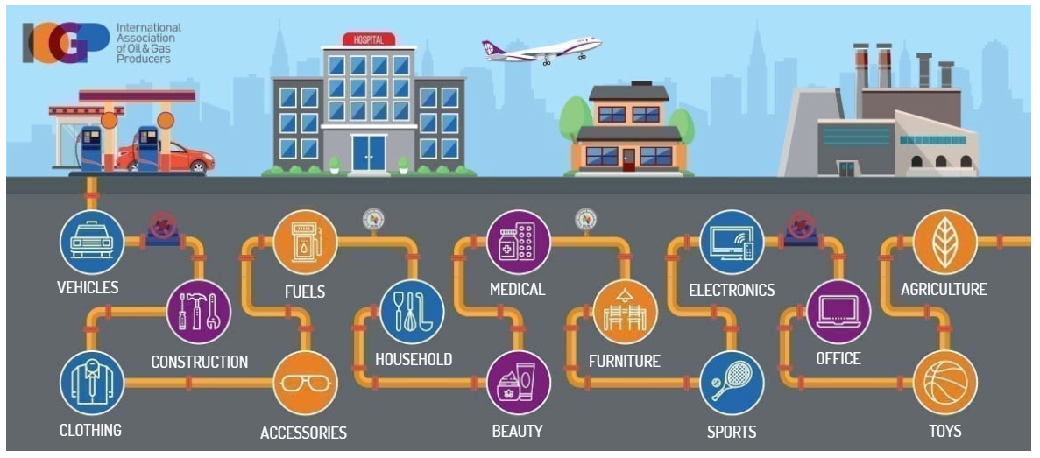
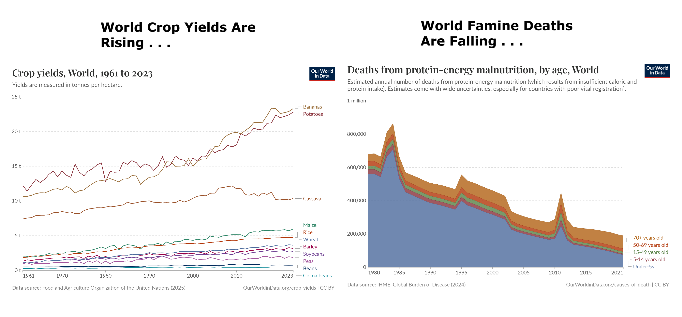
Why Hydrocarbons Rule
Even if all power generation, heating, and transportation were converted to non fossil fuel technology, it could reduce man-made CO2 emissions by 50%, but would have a negligible effect on global temperature. It would of course still be required to extract oil and natural gas from the ground for the manufacture of synthetic materials, plastics, asphalt, lubricants, fertilizers and pharmaceuticals.
The effect of today’s warming (and greening) on farming is, on average, positive: crops can be grown farther north and for longer seasons and rainfall is slightly heavier in dry regions. We are feeding over seven billion people today much more easily than we fed three billion in the 1960s, and from a similar acreage of farmland.

Slide 8
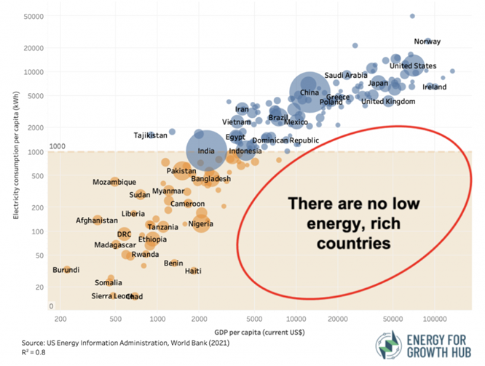
Why Hydrocarbons Rule

Slide 9
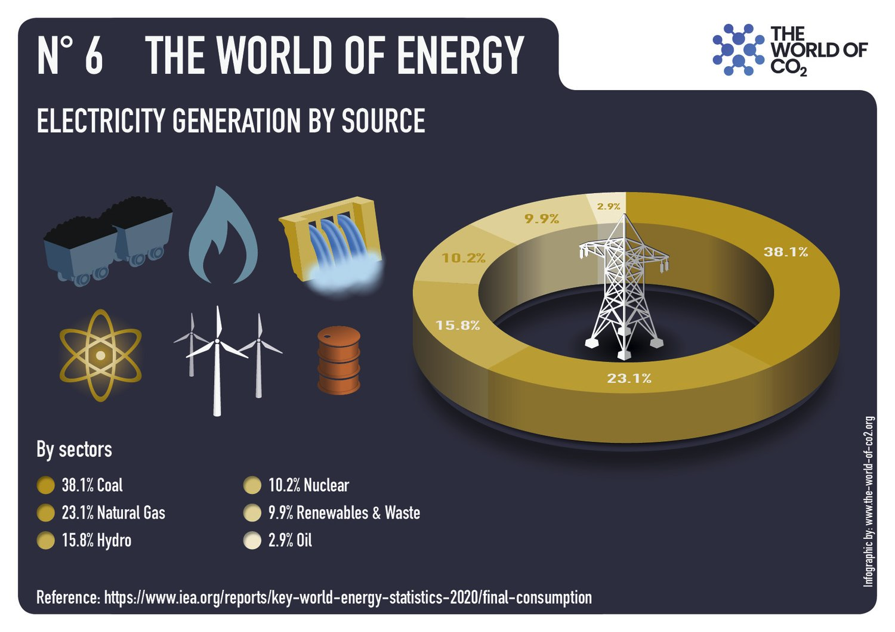
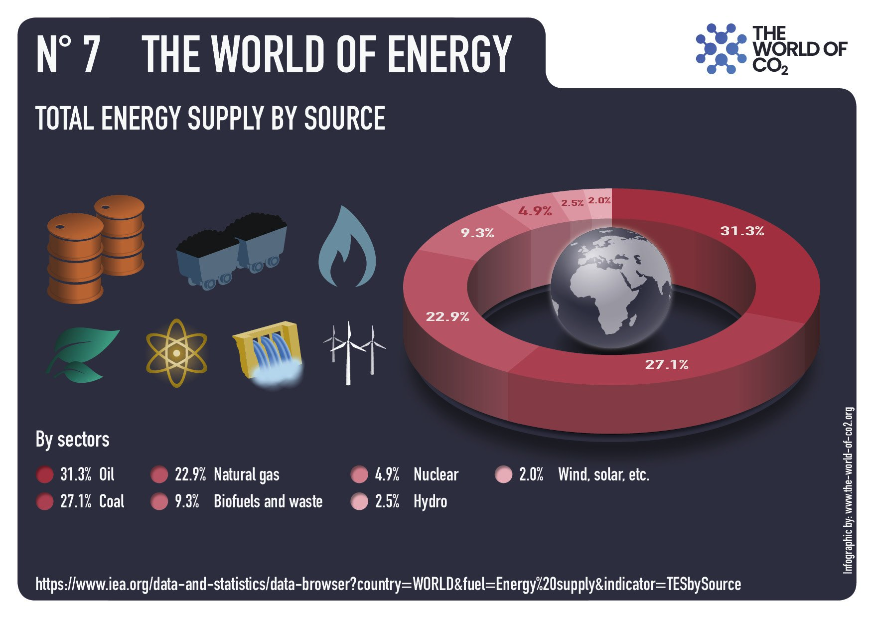
The World’s Energy Platform Depends on Hydrocarbons

Slide 10
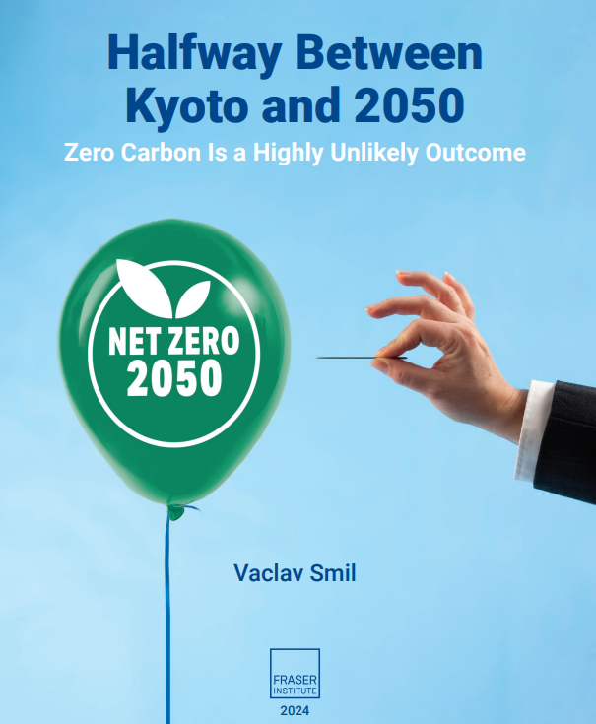
History is Not Bending to Climatist Desires

